Slide 1

Portfolio Projects
Evan Wong

Slide 2
Rich Goldman (page 03)
Loan application page (page 04)
Revolving Loan (page 05)
Web ERP System (page 08)
RentHub (Mobile app) (page 25)
List of Projects

Slide 3
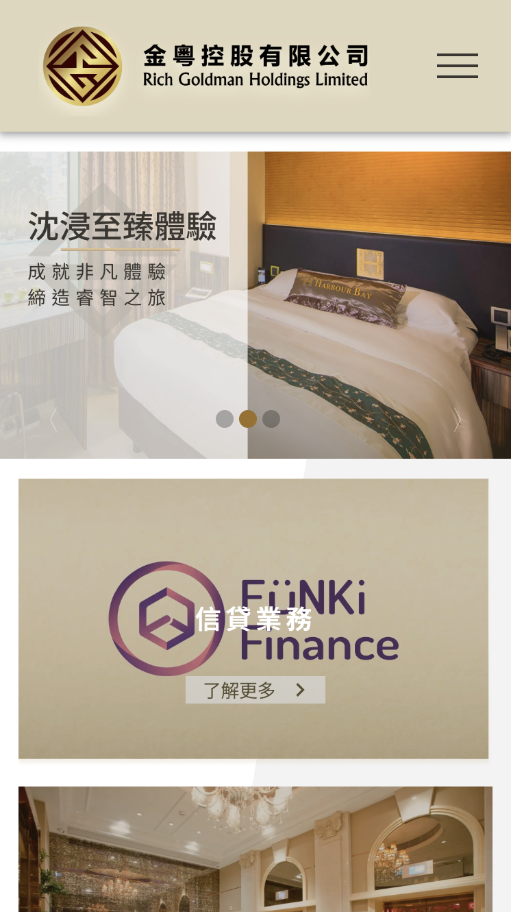
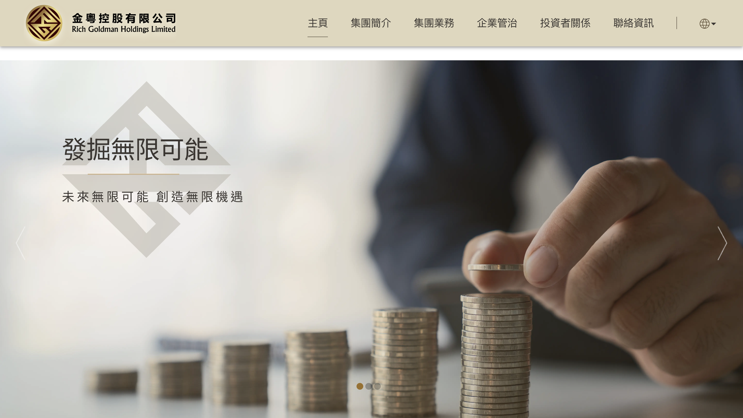
Website of Rich Goldman
URL: https://www.richgoldman.com.hk/zh

Slide 4
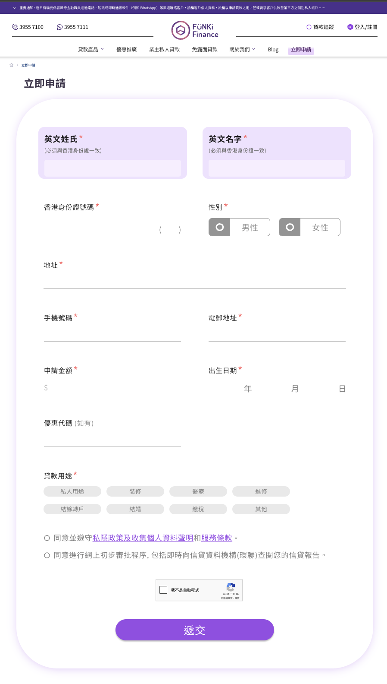
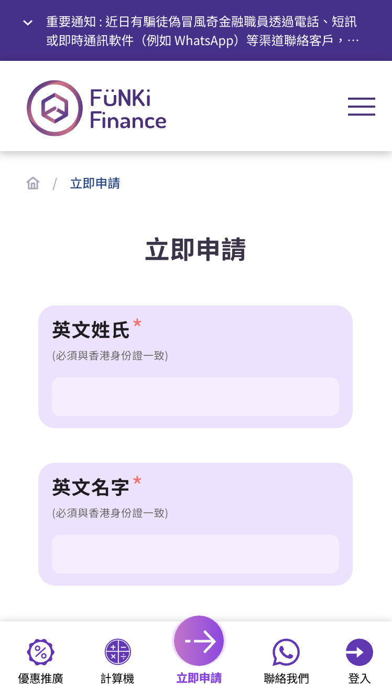
Apply Now, loan application page
URL: https://www.funki.com.hk/online-application

Slide 5
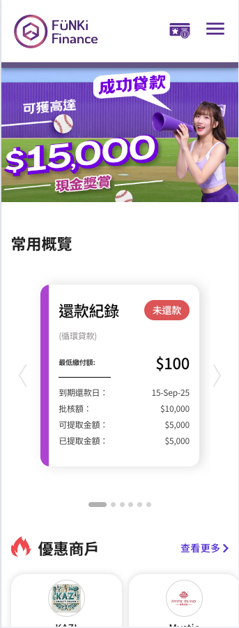
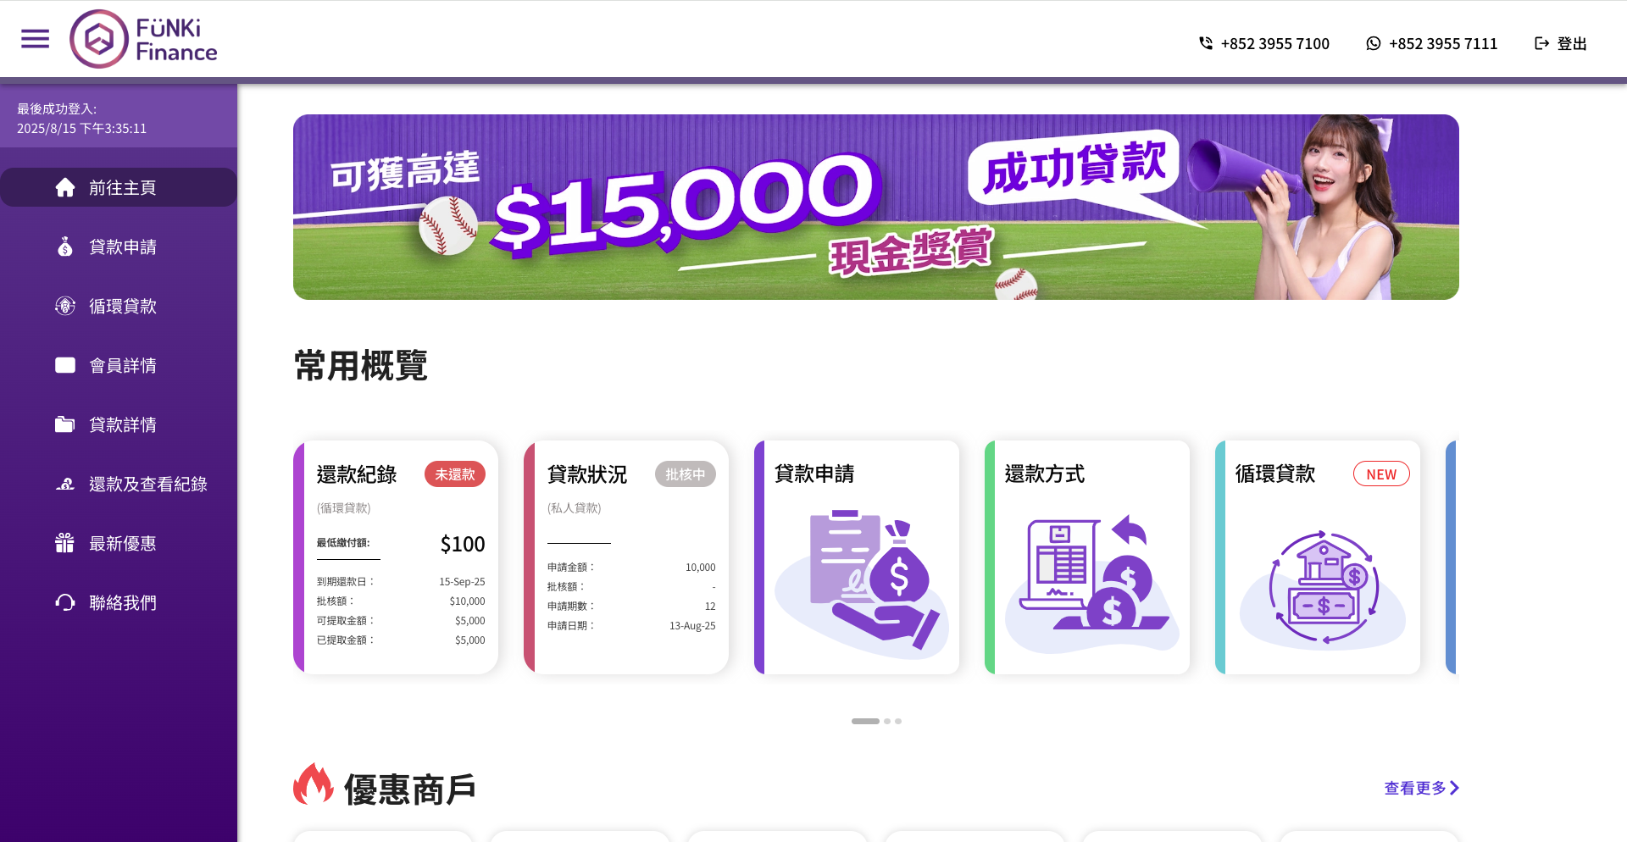
Revolving Loan, new financial product

Slide 6
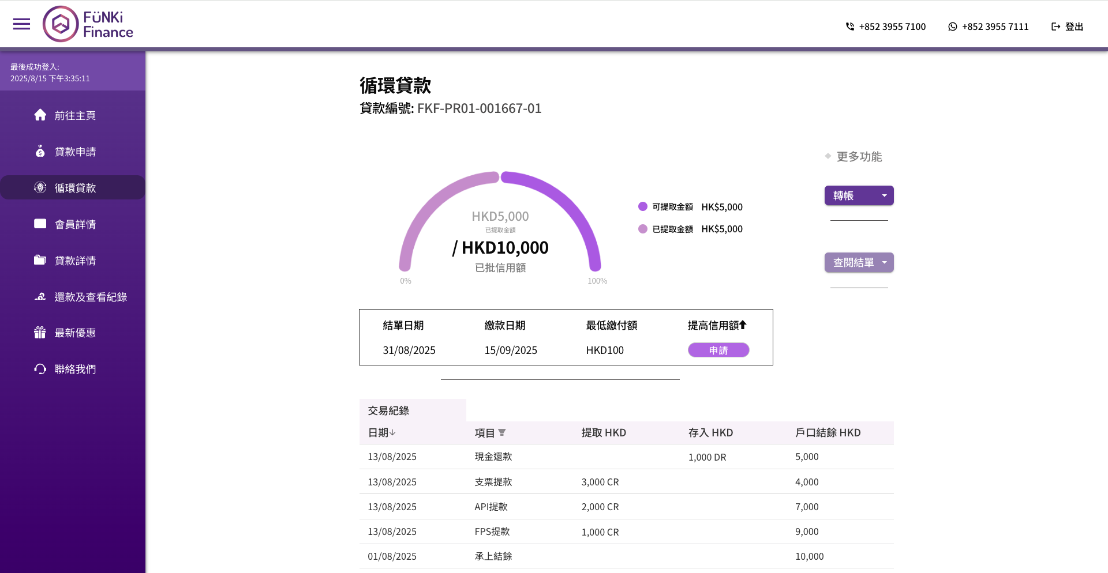
Revolving Loan, new financial product

Slide 7
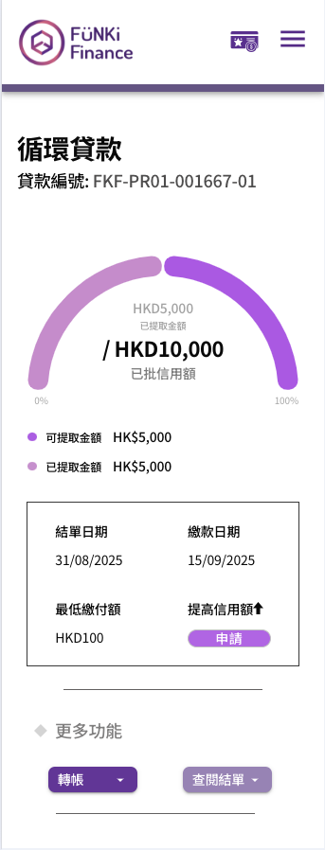
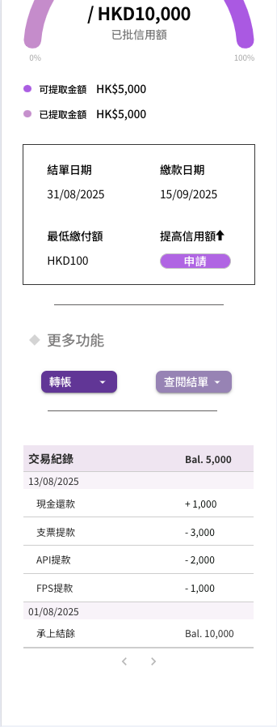
Revolving Loan, new financial product

Slide 8
#4
Web ERP System
GitHub:
https://github.com/Evan-Wong-FSD/ERP-Korise
Remark:
The following information is fictional; all confidential information has been redacted by .

Slide 9





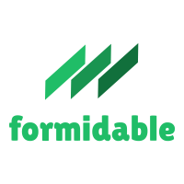




Tech stack
Front end
Vue.js, Vuex, Quasar Framework
Data communication
Axios, Socket.IO
Back end
Node.js, Express.js, Formidable, ExcelJS, MongoDB

Slide 10
Main functions
Financial management
Including accounting, financial reporting, budget management, and cost control functionalities.
Project management
Managing project schedules, resource allocation, and project costs.
Production management
Planning and controlling the production process, including material requirements planning and resource allocation.
Purchasing management
Managing the procurement process, including supplier selection, purchase orders, and supplier payments.
Inventory management
Tracking and managing inventory levels.
Creating material codes for inventories to establish a standardized and structured system for identifying and categorizing inventory items.
Customer and Supplier management
Tracking customers and suppliers information.

Slide 11
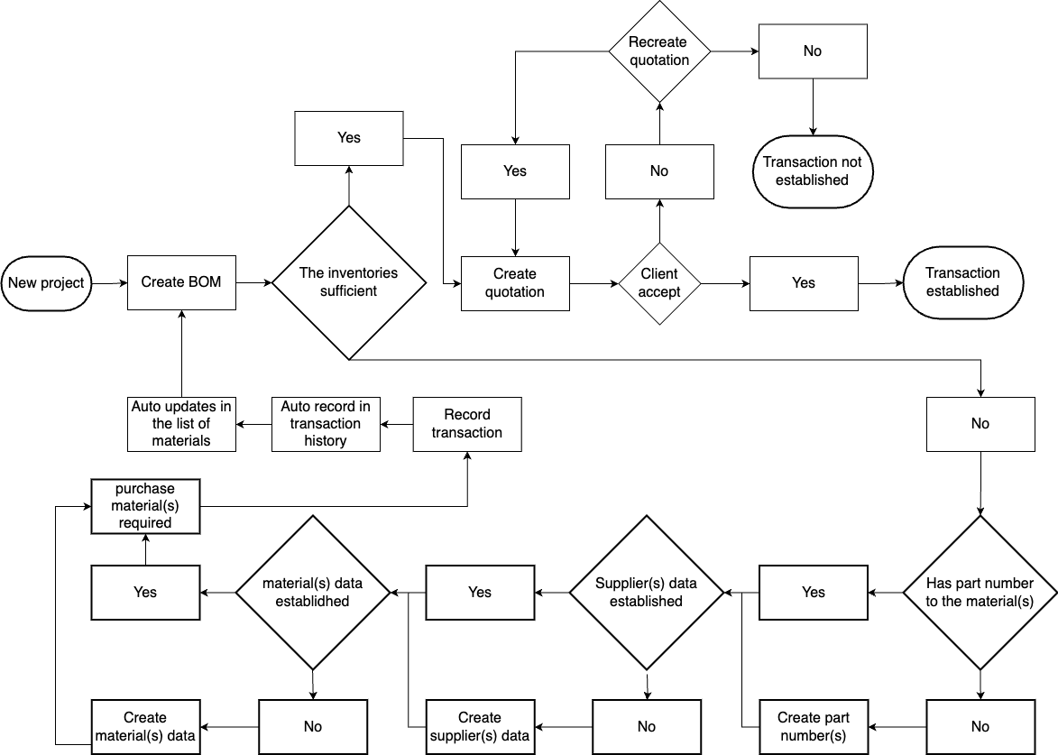
Flow chart

Slide 12
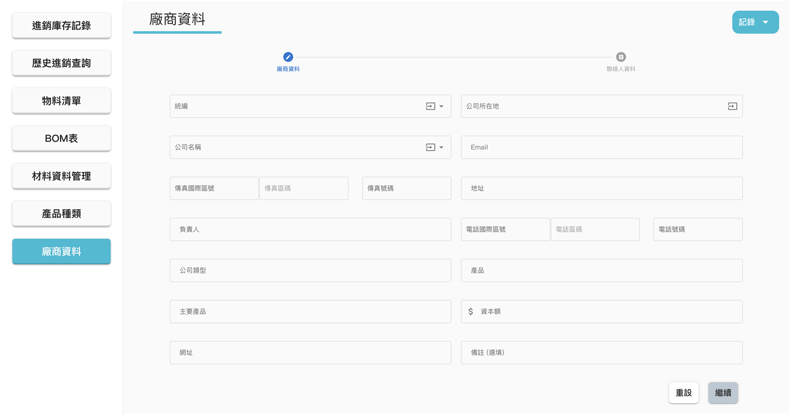
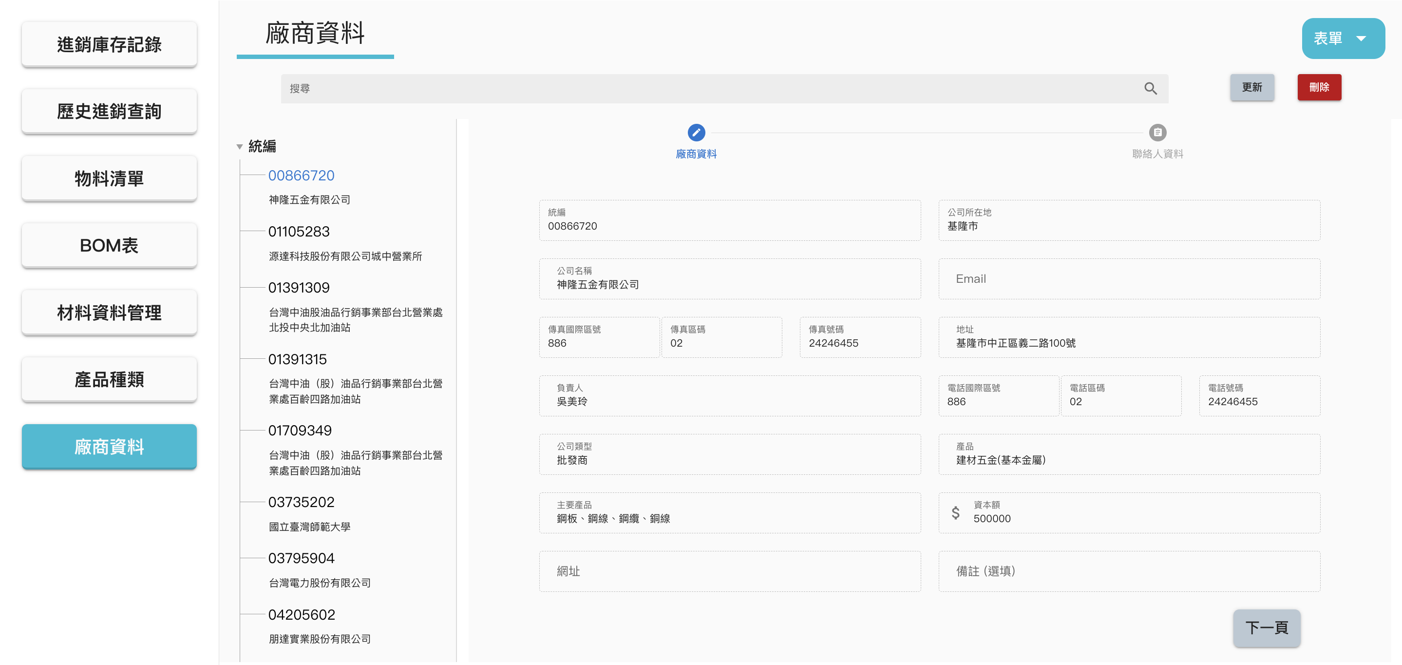
Customers and Suppliers information
Customer and Supplier management
Record customer and supplier data.
Validate user-entered data before submission to ensure compliance with rules and prevent duplicates.
Provide CRUD functionality.
Open update dialog
Search bar
Open delete confirmation
List of firms

Slide 13
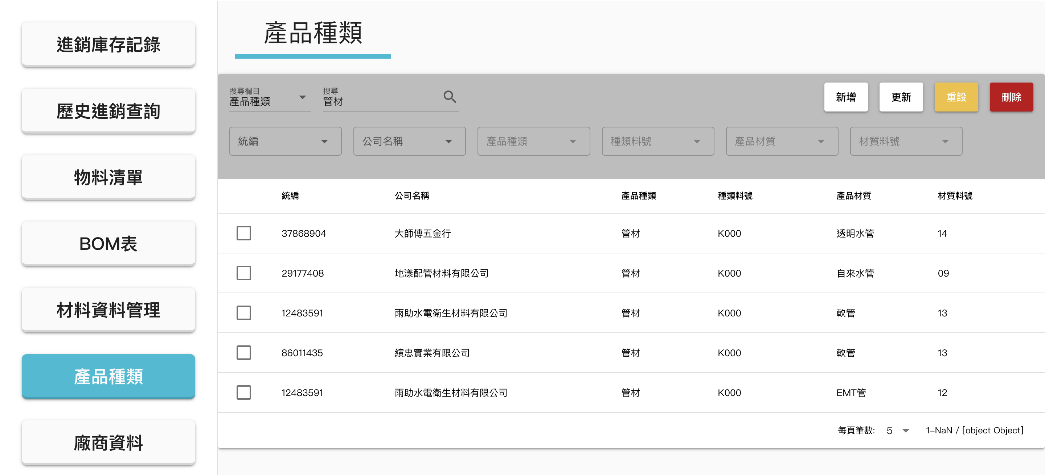
Materials classification
Search field
Input field

Slide 14
Materials classification
Inventory Management
Manage (CRUD) part numbers help the company track the flow of materials in the supply chain. By assigning part numbers, the company can accurately identify each material and replenish inventory when needed, ensuring an adequate supply while avoiding overstock or stockouts.
Quality Control
Part numbers enable precise identification and tracking of different materials. This helps ensure consistent product quality and facilitates quick traceability to specific material batches or suppliers in case of defects or issues.
Supply Chain Coordination
In the supply chain, the company interact and collaborate with suppliers, manufacturers, and distributors. Using part numbers allows different trading partners to precisely identify and communicate specific materials, ensuring accuracy and consistency in orders and deliveries.
Cost Management
Part numbers assist in better cost management. By assigning standardized numbers and tracking materials, the company can more easily analyze and compare prices and performance from different suppliers, enabling more informed procurement and sourcing decisions.
Efficiency Improvement
The use of part numbers can enhance internal process efficiency. For example, in procurement and manufacturing, using part numbers simplifies the ordering process, reduces errors and confusion, and speeds up material sourcing and production schedules.

Slide 15
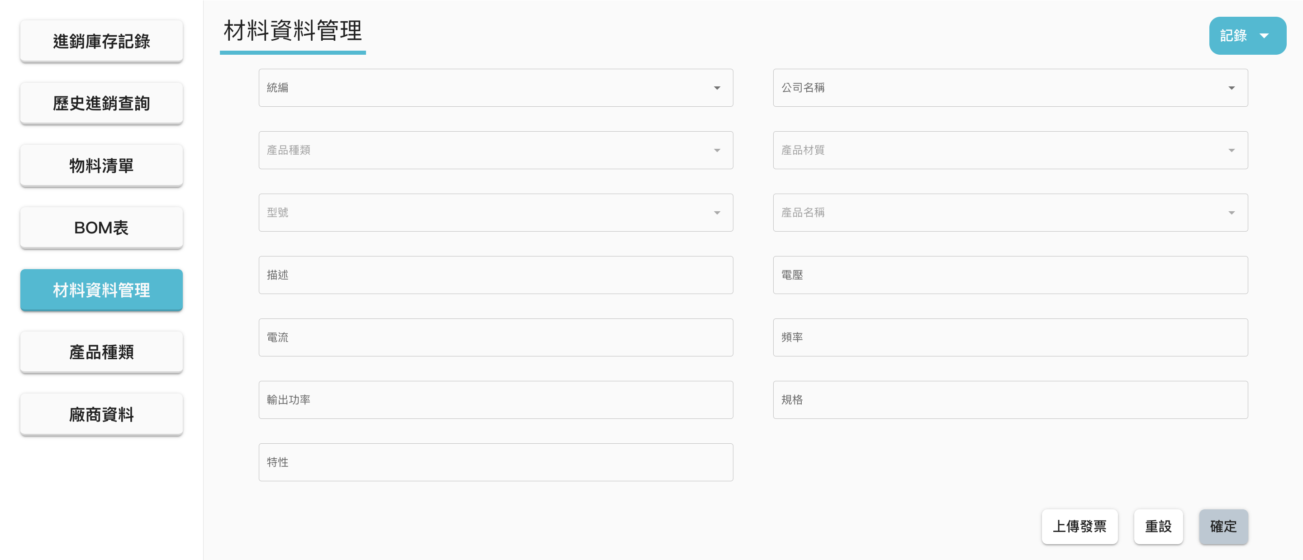
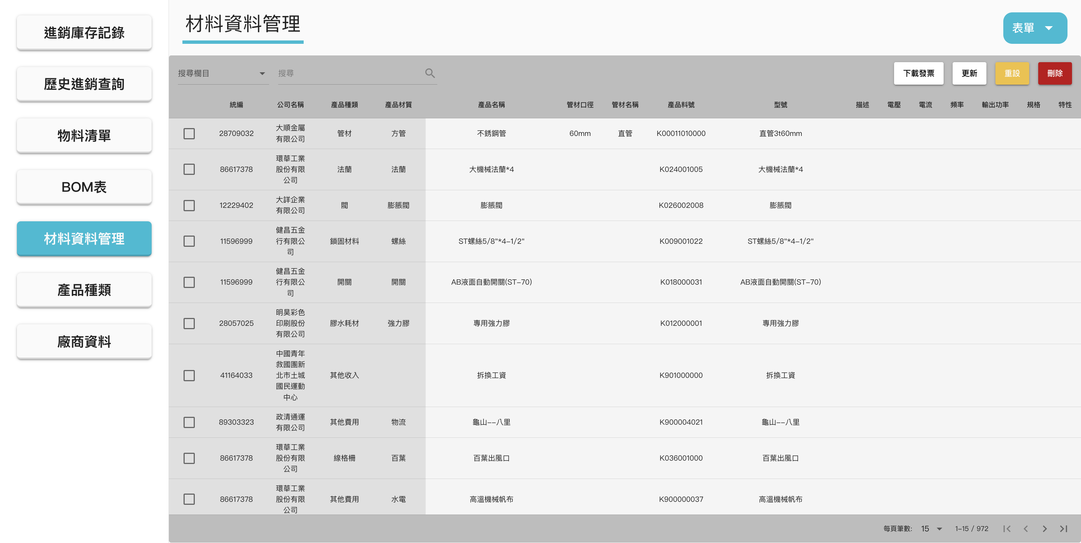
Material Management
Inventory management
Record, track, and manage (CRUD) detailed information about materials, inventory levels, supplier information, and part numbers.
Upload / Download invoice
Upload invoices before submitting material data for future downloading and viewing.
Facilitate comparison of supplier price increases.
Helps the accountant record purchase costs accurately and supports activities such as tax filings, cost calculations, and financial analysis.
Uplad invoice
Download invoice

Slide 16
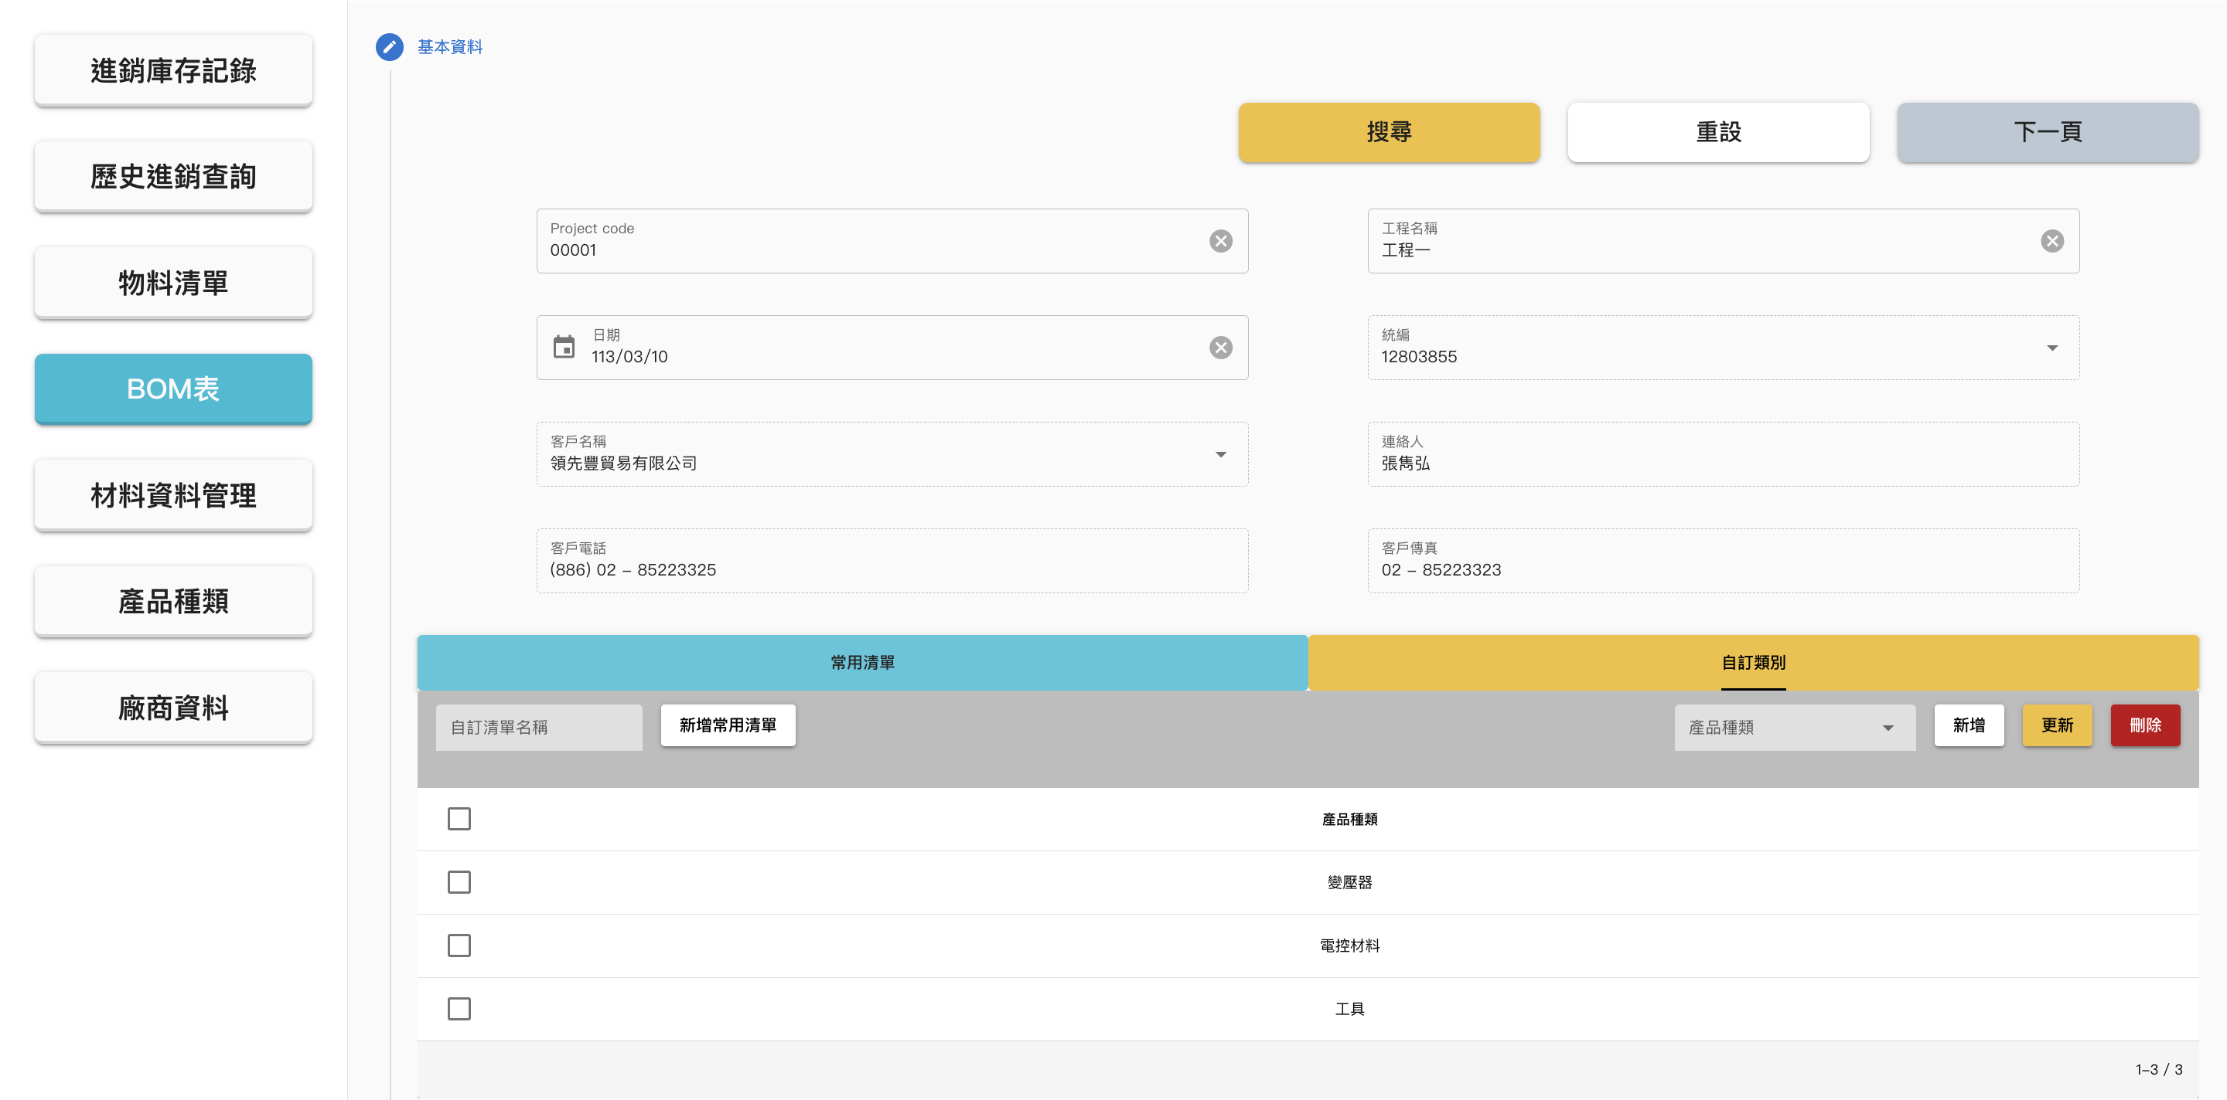
Bill of Material (BOM) / Quotation
Basic information
Header in the sheet
Generate BOM or Quotation
A Bill of Materials (BOM) is a comprehensive list of items, parts, assemblies, and materials required to produce or manufacture a specific finished product. It serves as a blueprint for creating the product.
A quotation, also known as a quote, is a fixed-price proposal provided to a customer. It outlines the cost of a product or service and cannot be modified once the customer agrees.
Materials classification applied in the sheet

Slide 17
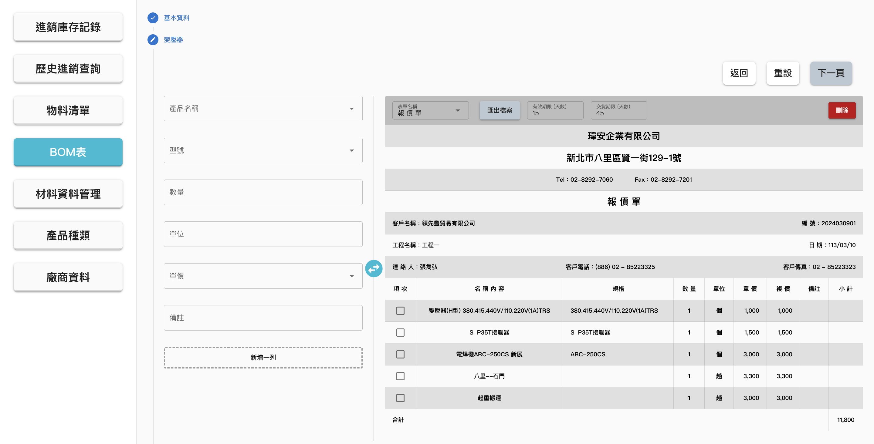

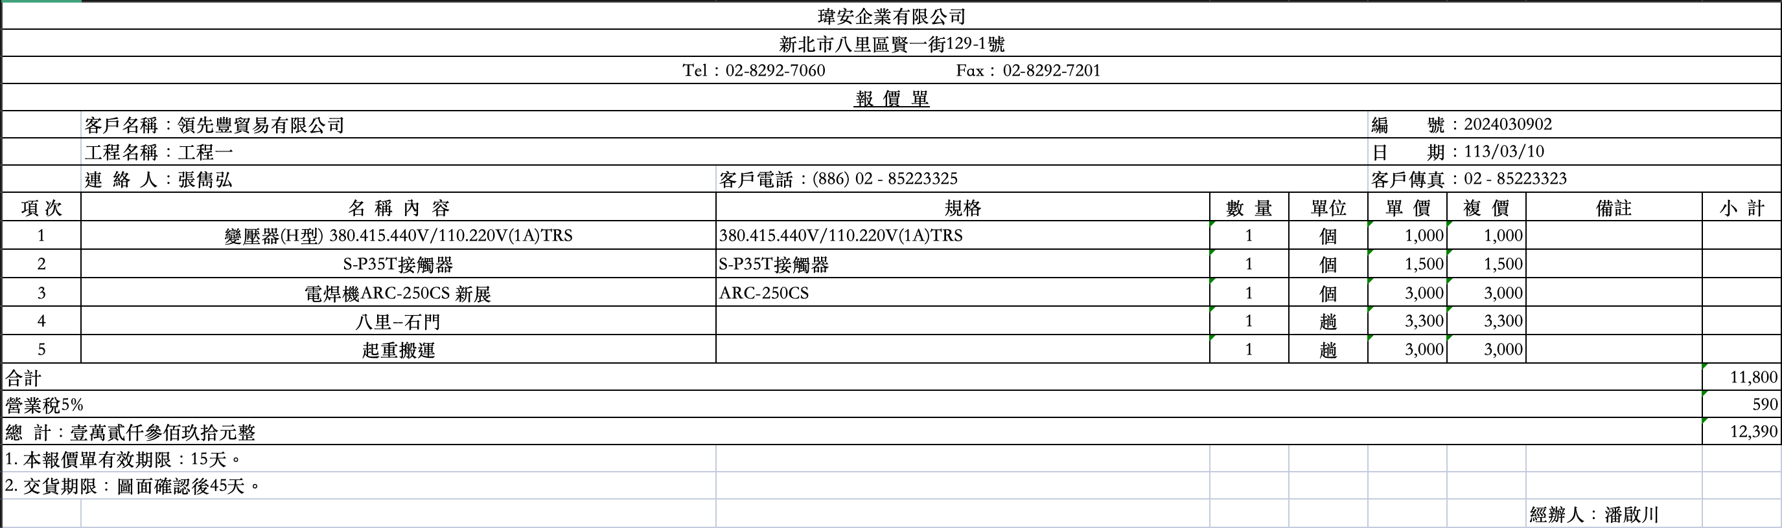
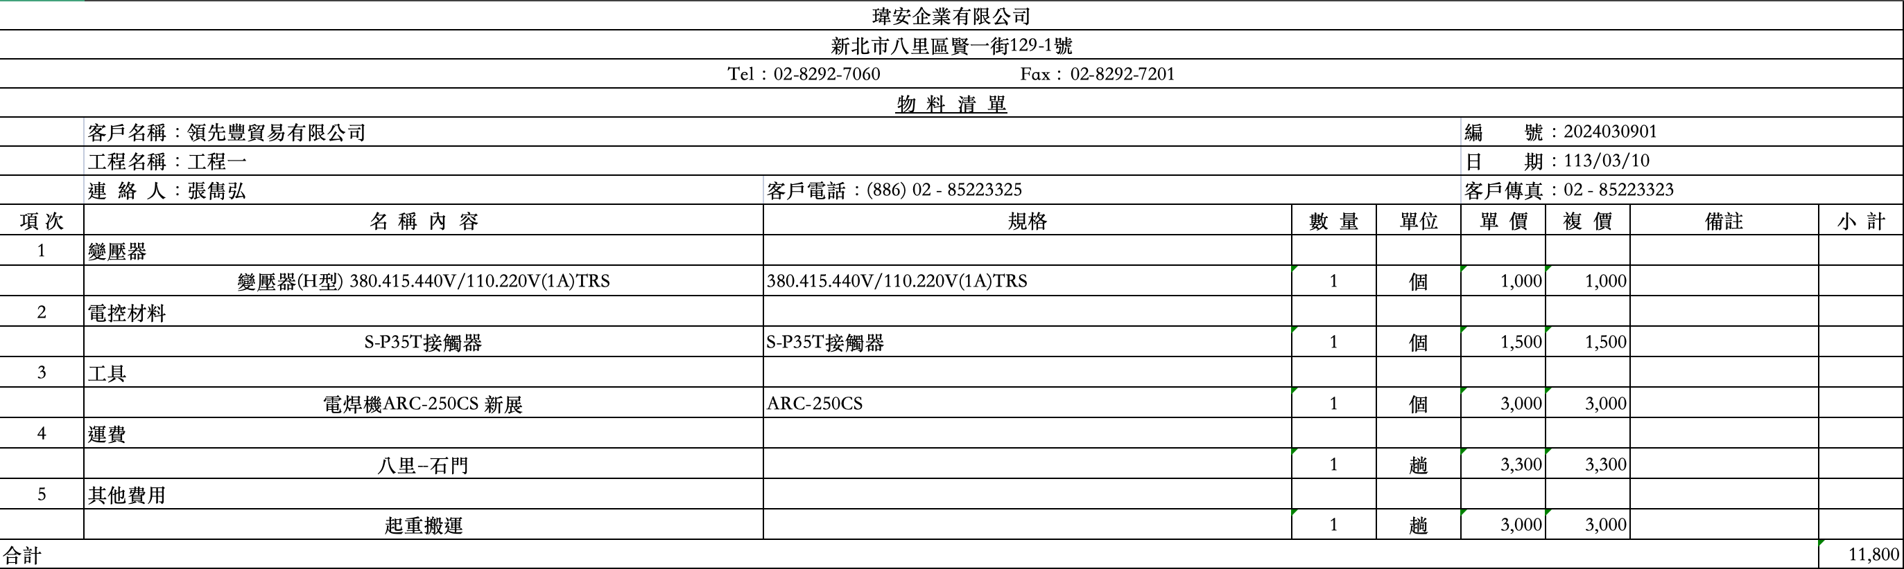
Bill of Material (BOM) / Quotation
Select type of sheet
Select type of sheet
Input field
Export Excel file
Click to insert data into sheet

Slide 18
Bill of Material (BOM) / Quotation
Data input reminders
Only allow users to select materials with available inventory to avoid issues from insufficient stock.
Provide inventory quantity alerts.
Display an insufficient stock warning when the input quantity exceeds the material's inventory level.
Enhancement of managements
Financial management: include budget management and cost control functionalities.
Production management: plan the production process, including material requirements planning, production scheduling, and resource allocation.
Project management: manage project schedules, resource allocation, and project costs.
Flexibility of data display and manipulation
Real-time data synchronization in the form of instant data review and reduced errors.
Instantly switch between BOM and Quotation form templates.
Provide Excel export functionality for time-saving compilation.

Slide 19
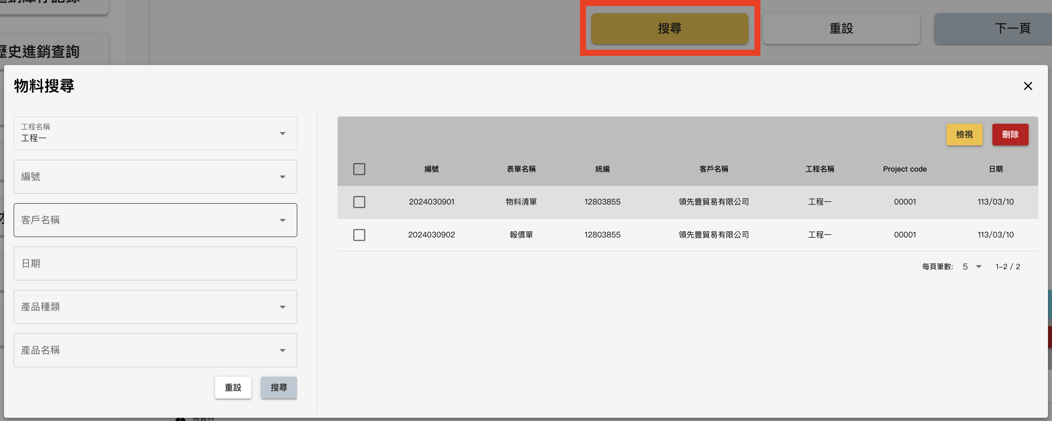
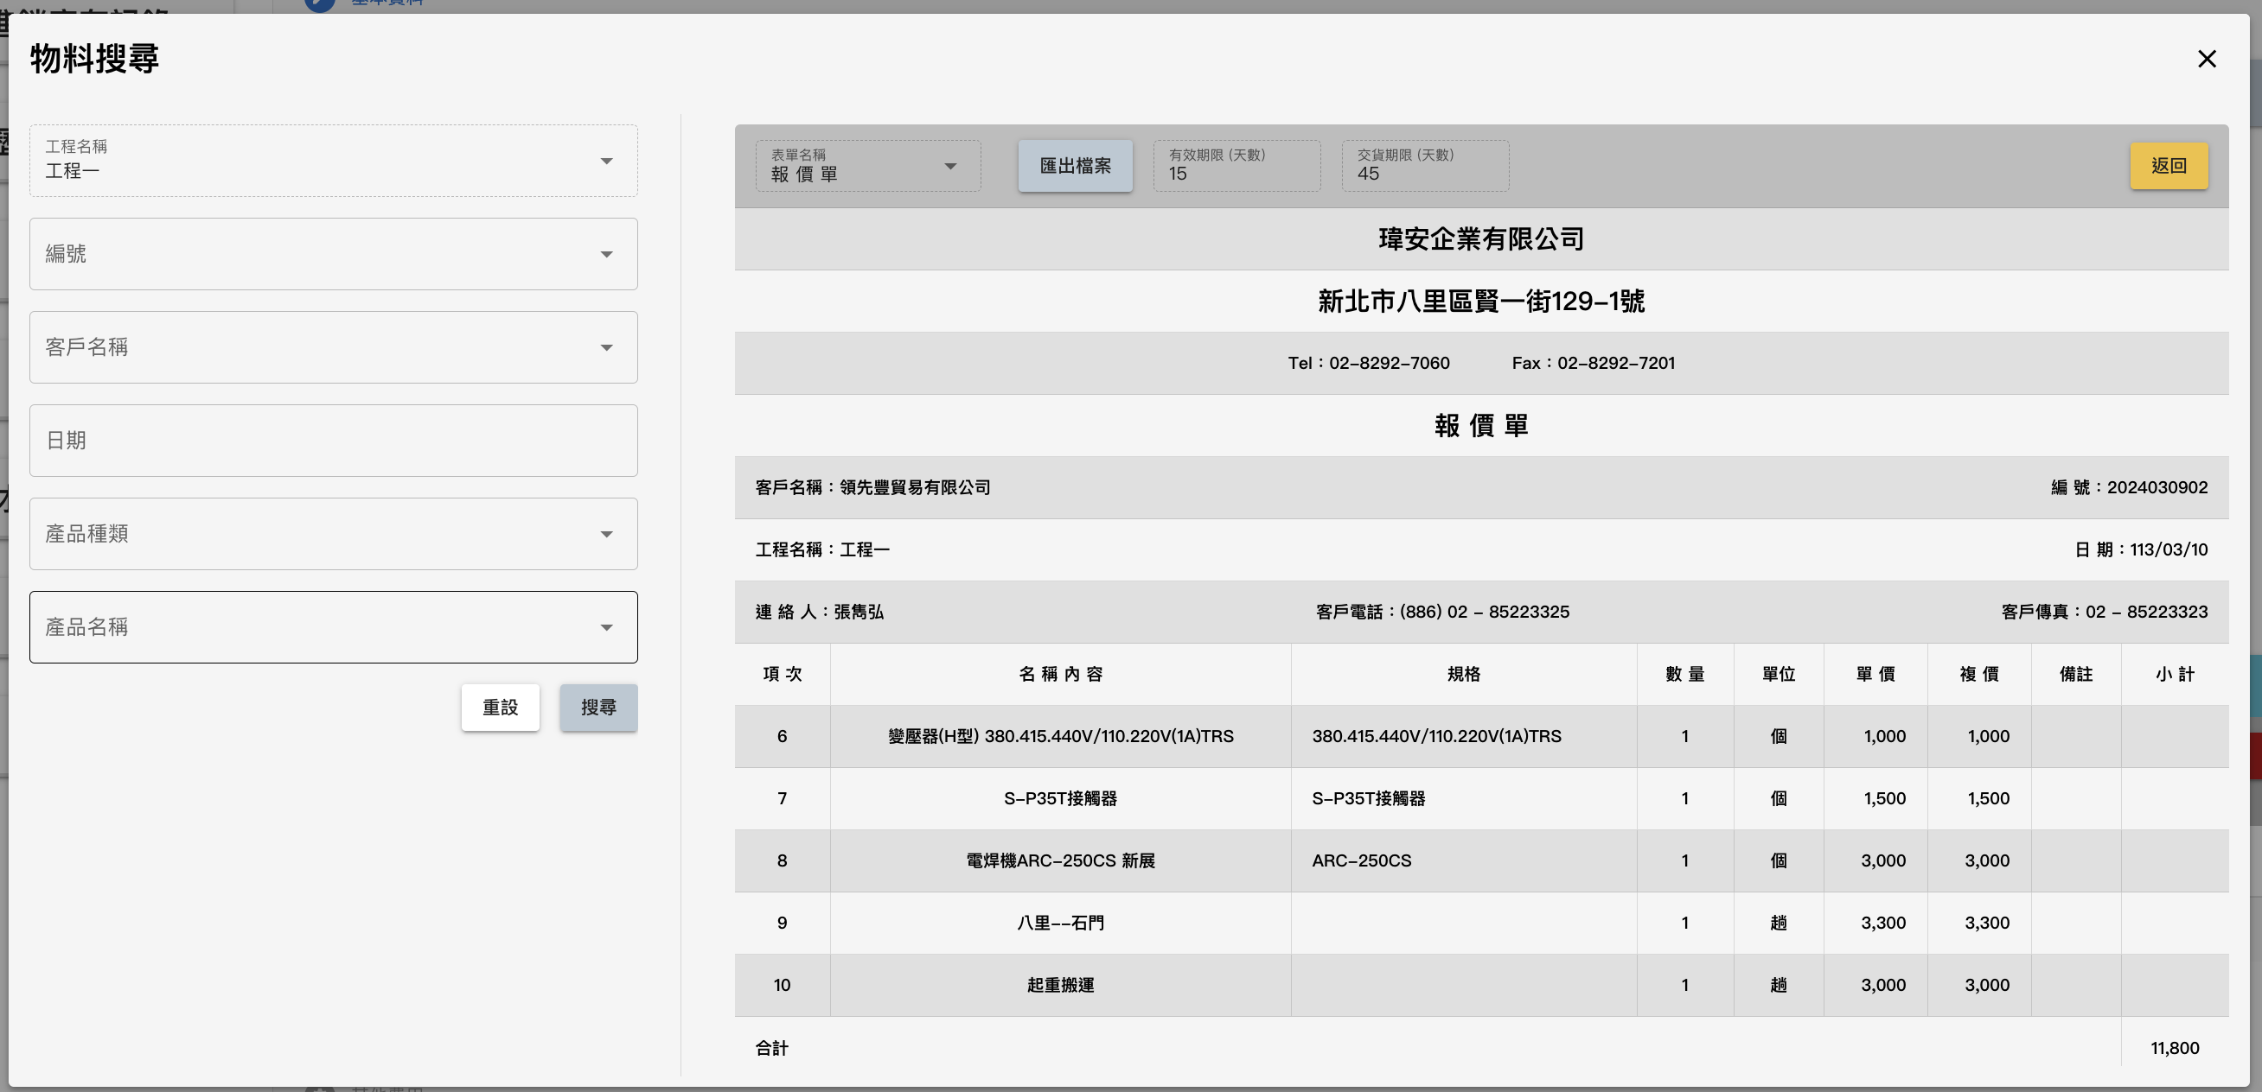
Bill of Material (BOM) / Quotation
Open search dialog
View details
Input keyword
Provide search functionality
Easily search BOM or Quotation by entering any search criteria.
Ability to delete specified BOM or Quotation from the search results.
Provide Excel export functionality.
Search
Export Excel file

Slide 20
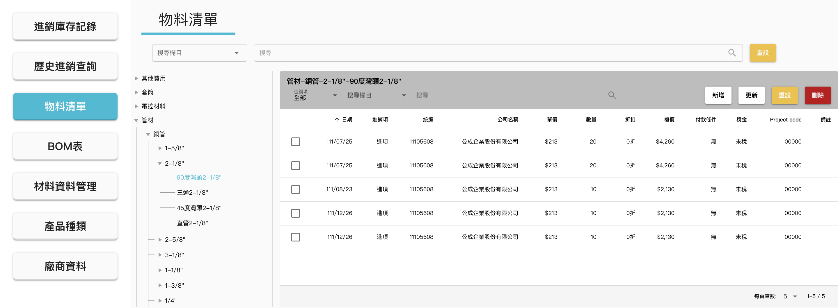
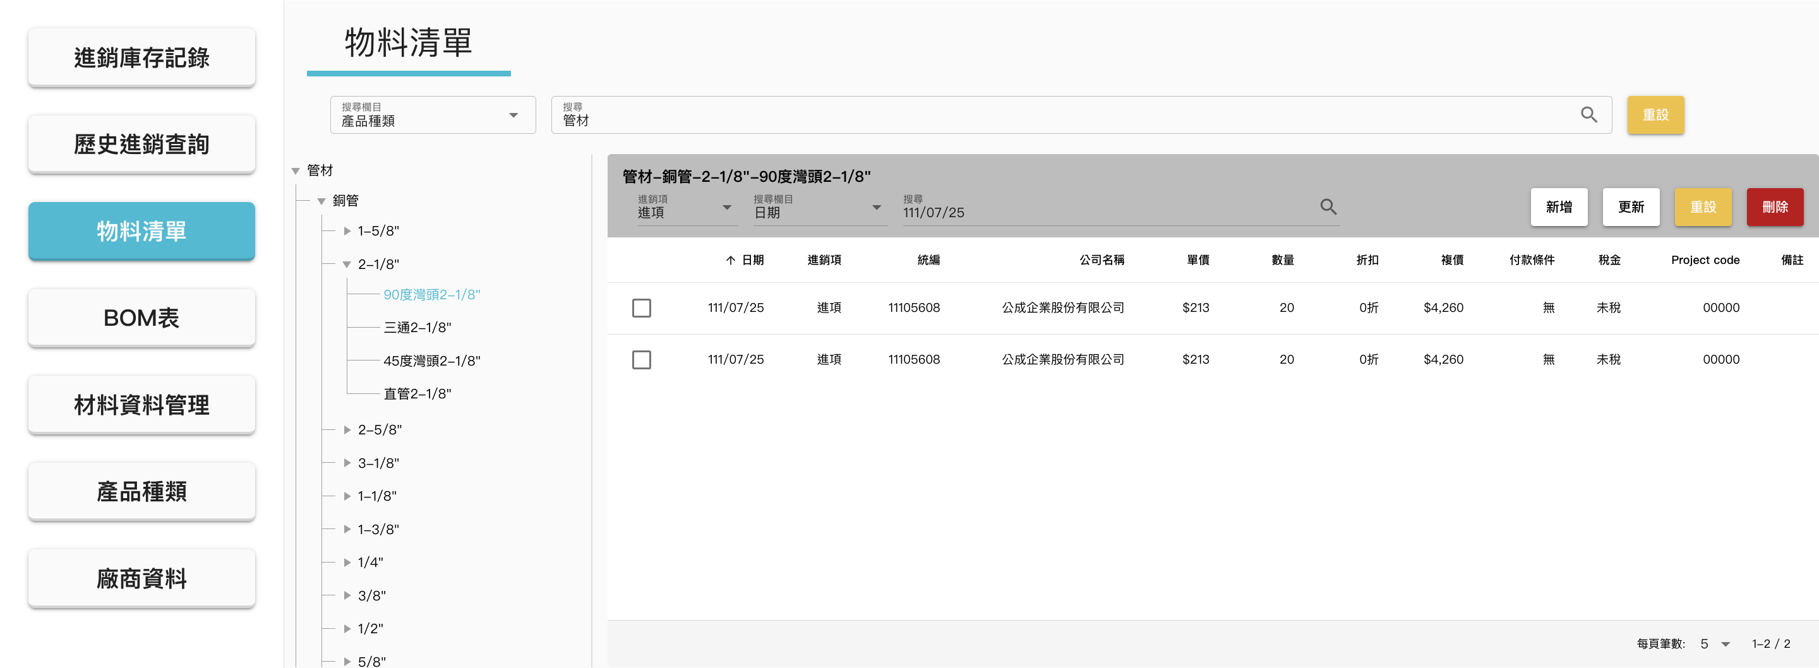
List of materials
Materials tree menu
Inventory management
Track and manage (CRUD) inventory levels and supplier information for materials.
Provide convenient search functionality for users to quickly find the requested material data.
By leveraging recorded material data, the company could compare quotes from different suppliers and identify materials with the most competitive prices.
Efficiently compare whether suppliers have adjusted prices.
Search field

Slide 21
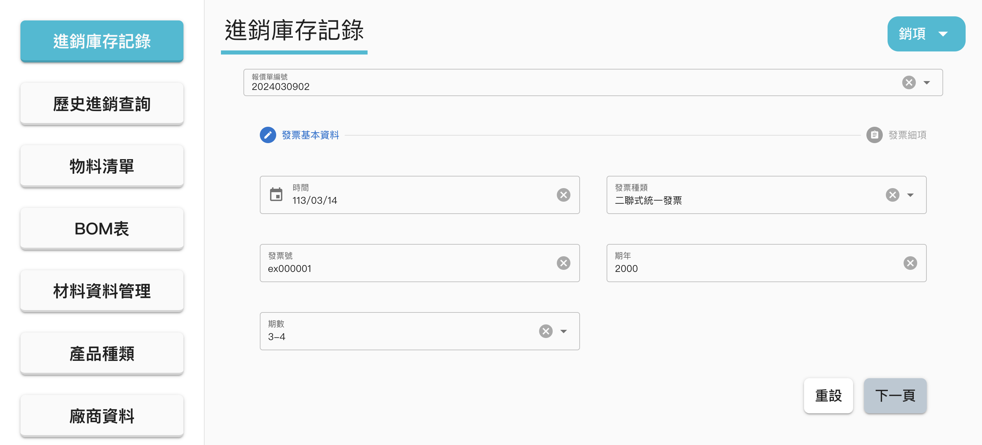
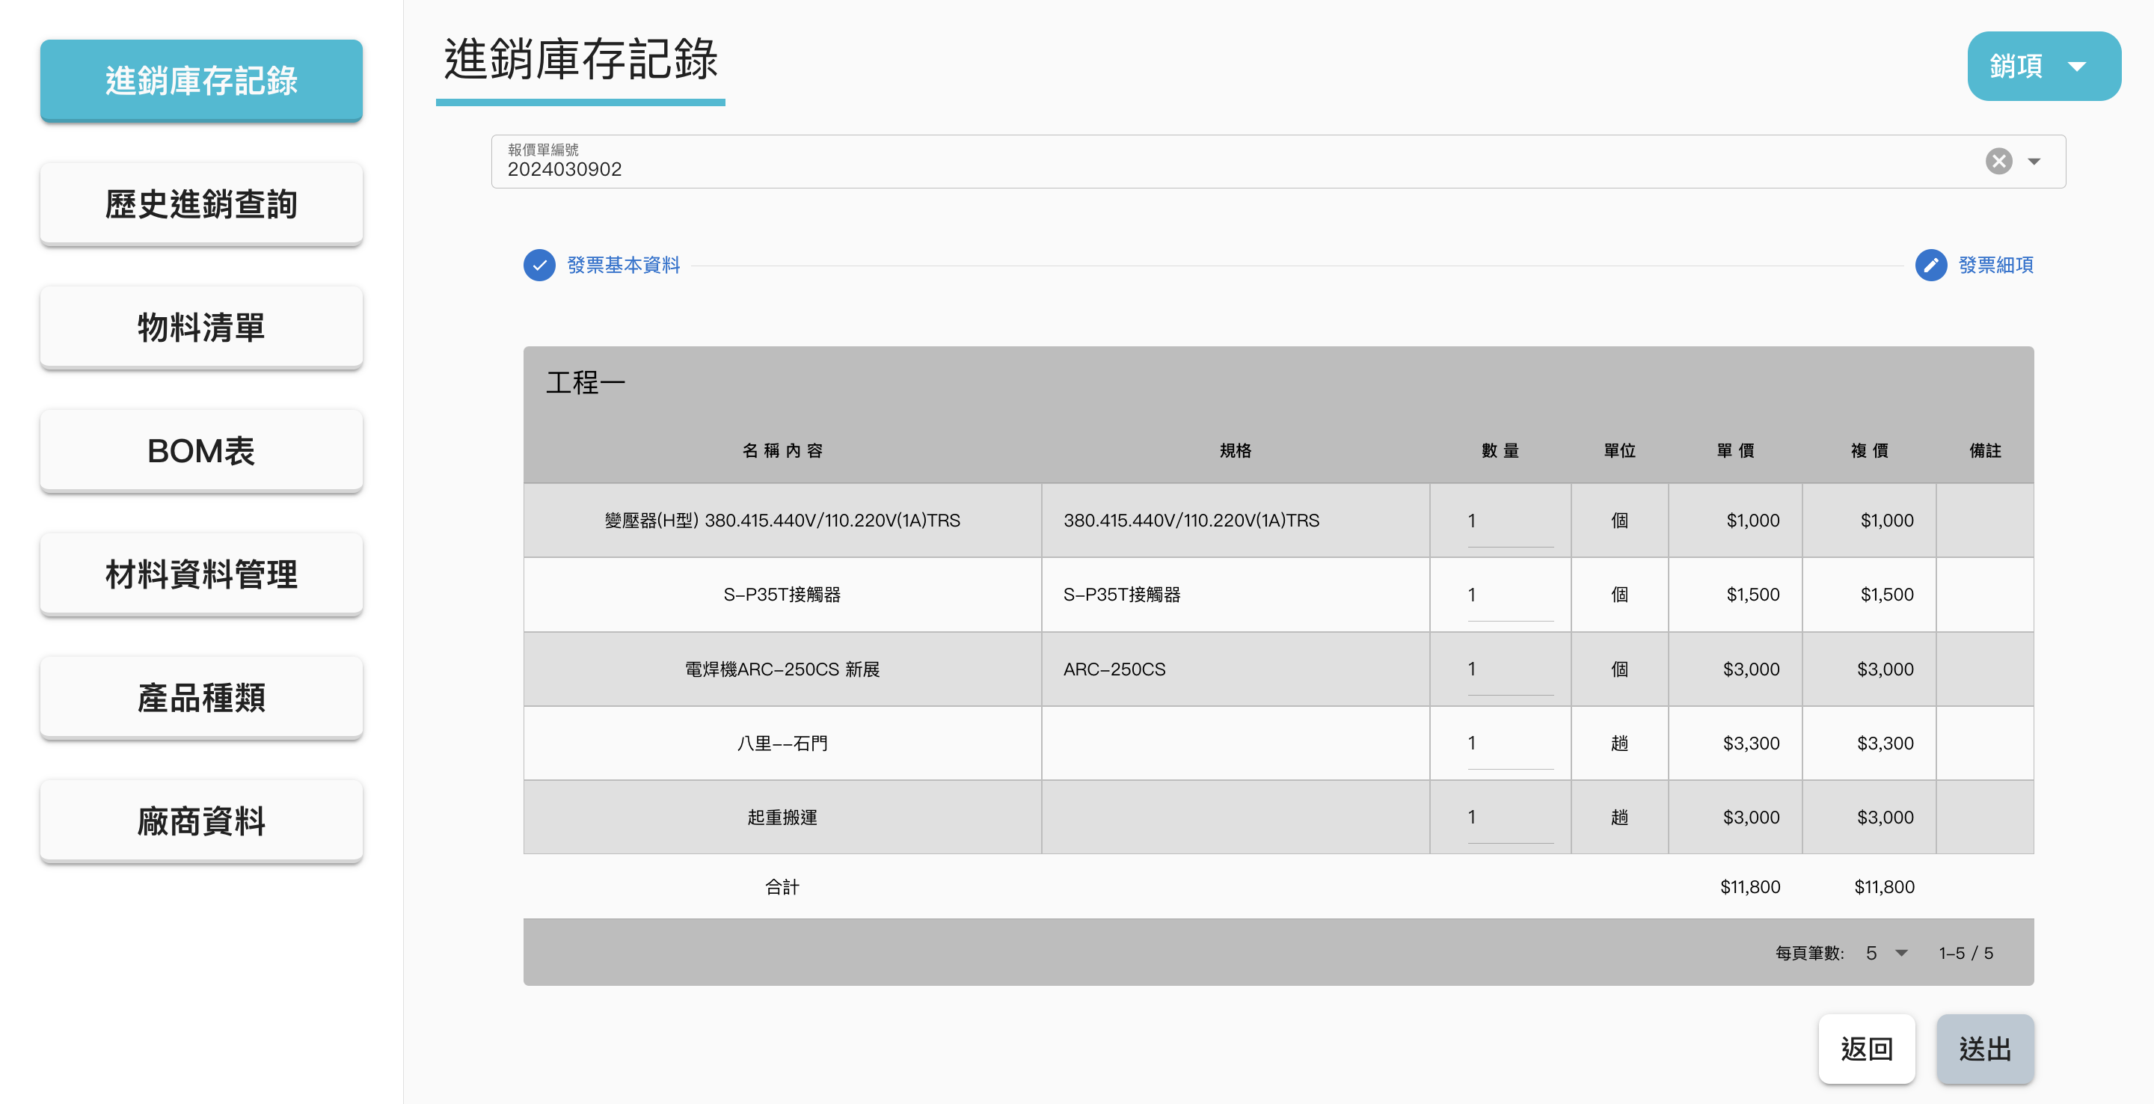
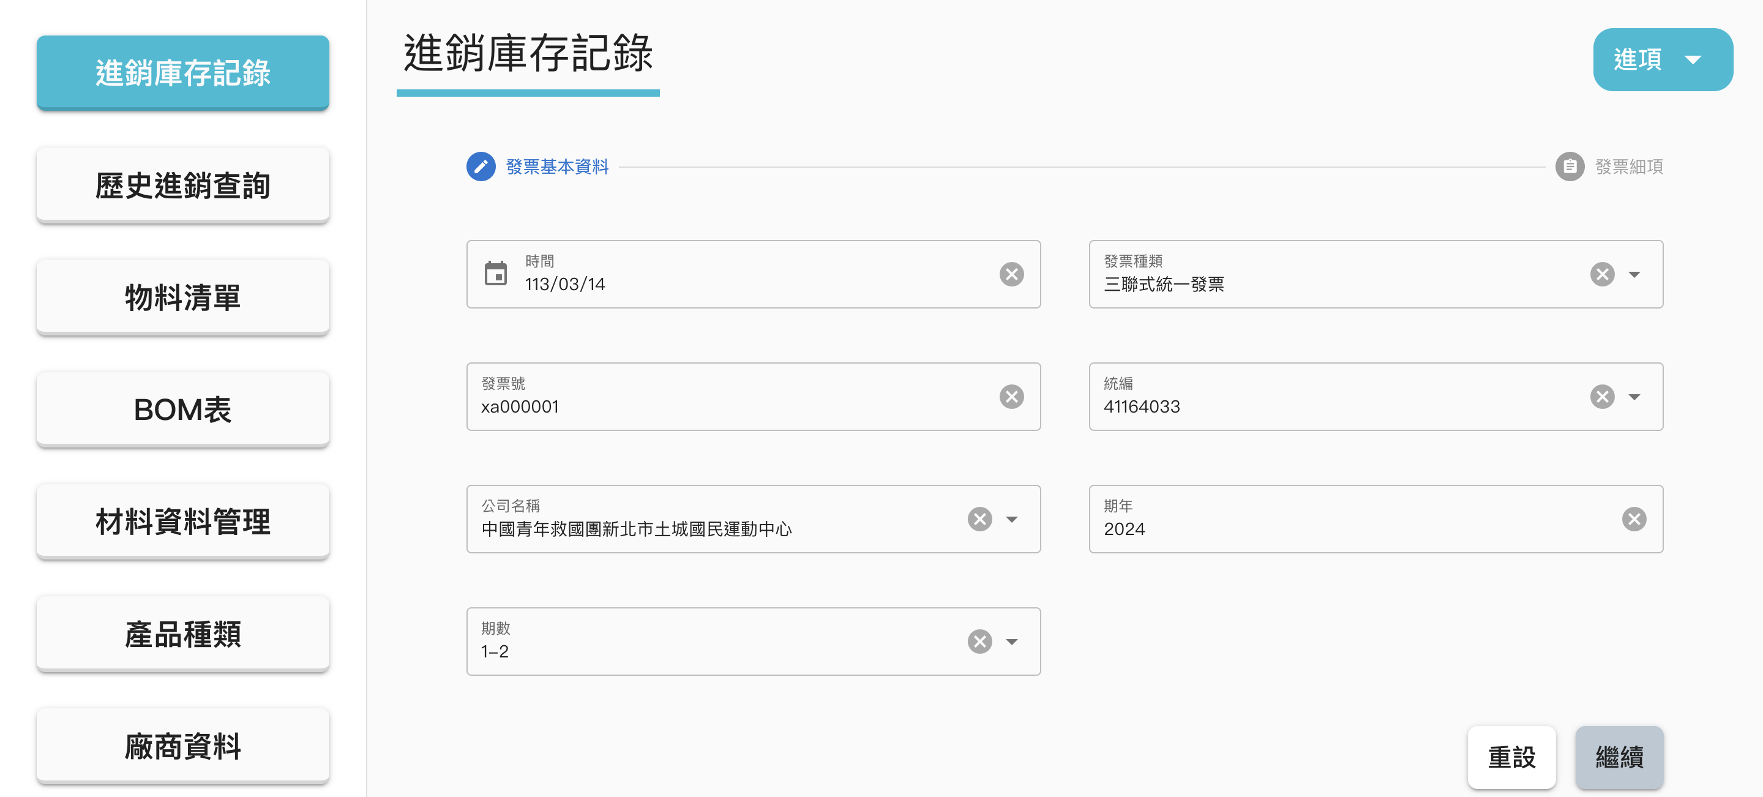
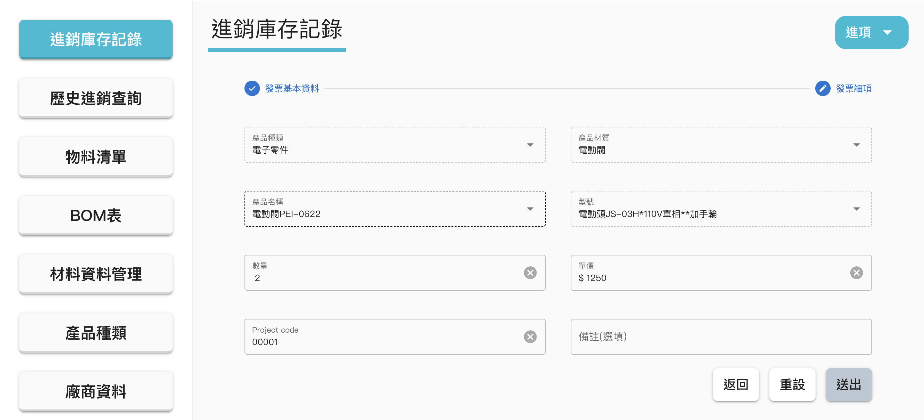
2. Input sales data
Transaction record
Transaction management
Create transaction records, including information on suppliers/customers, orders and payments/revenues.
1. Input ID of Quotation
Inventory management
Based on purchase or sales records, automatically increase or decrease the inventory levels.

Slide 22
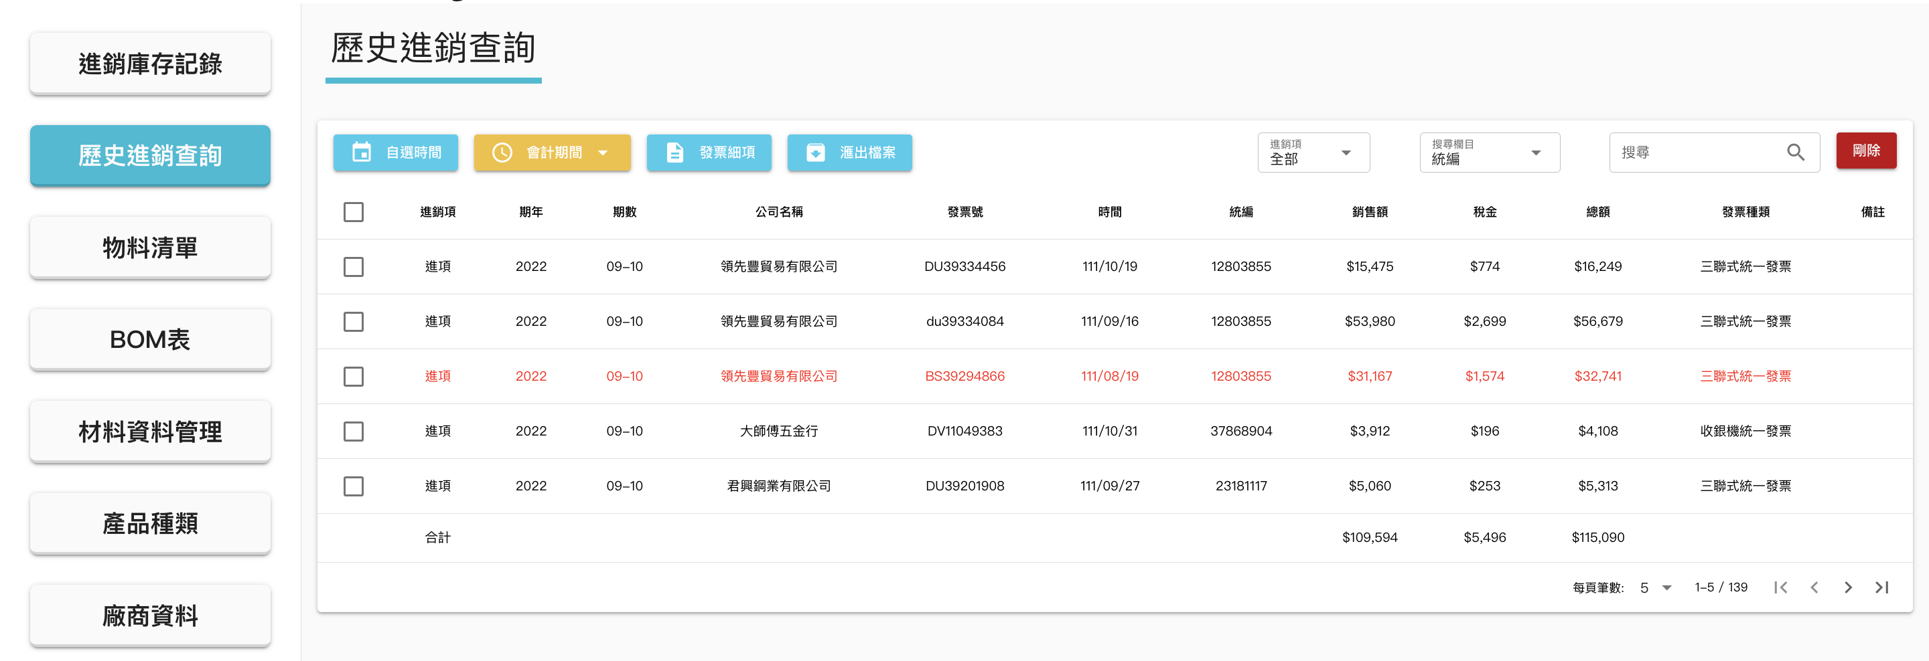
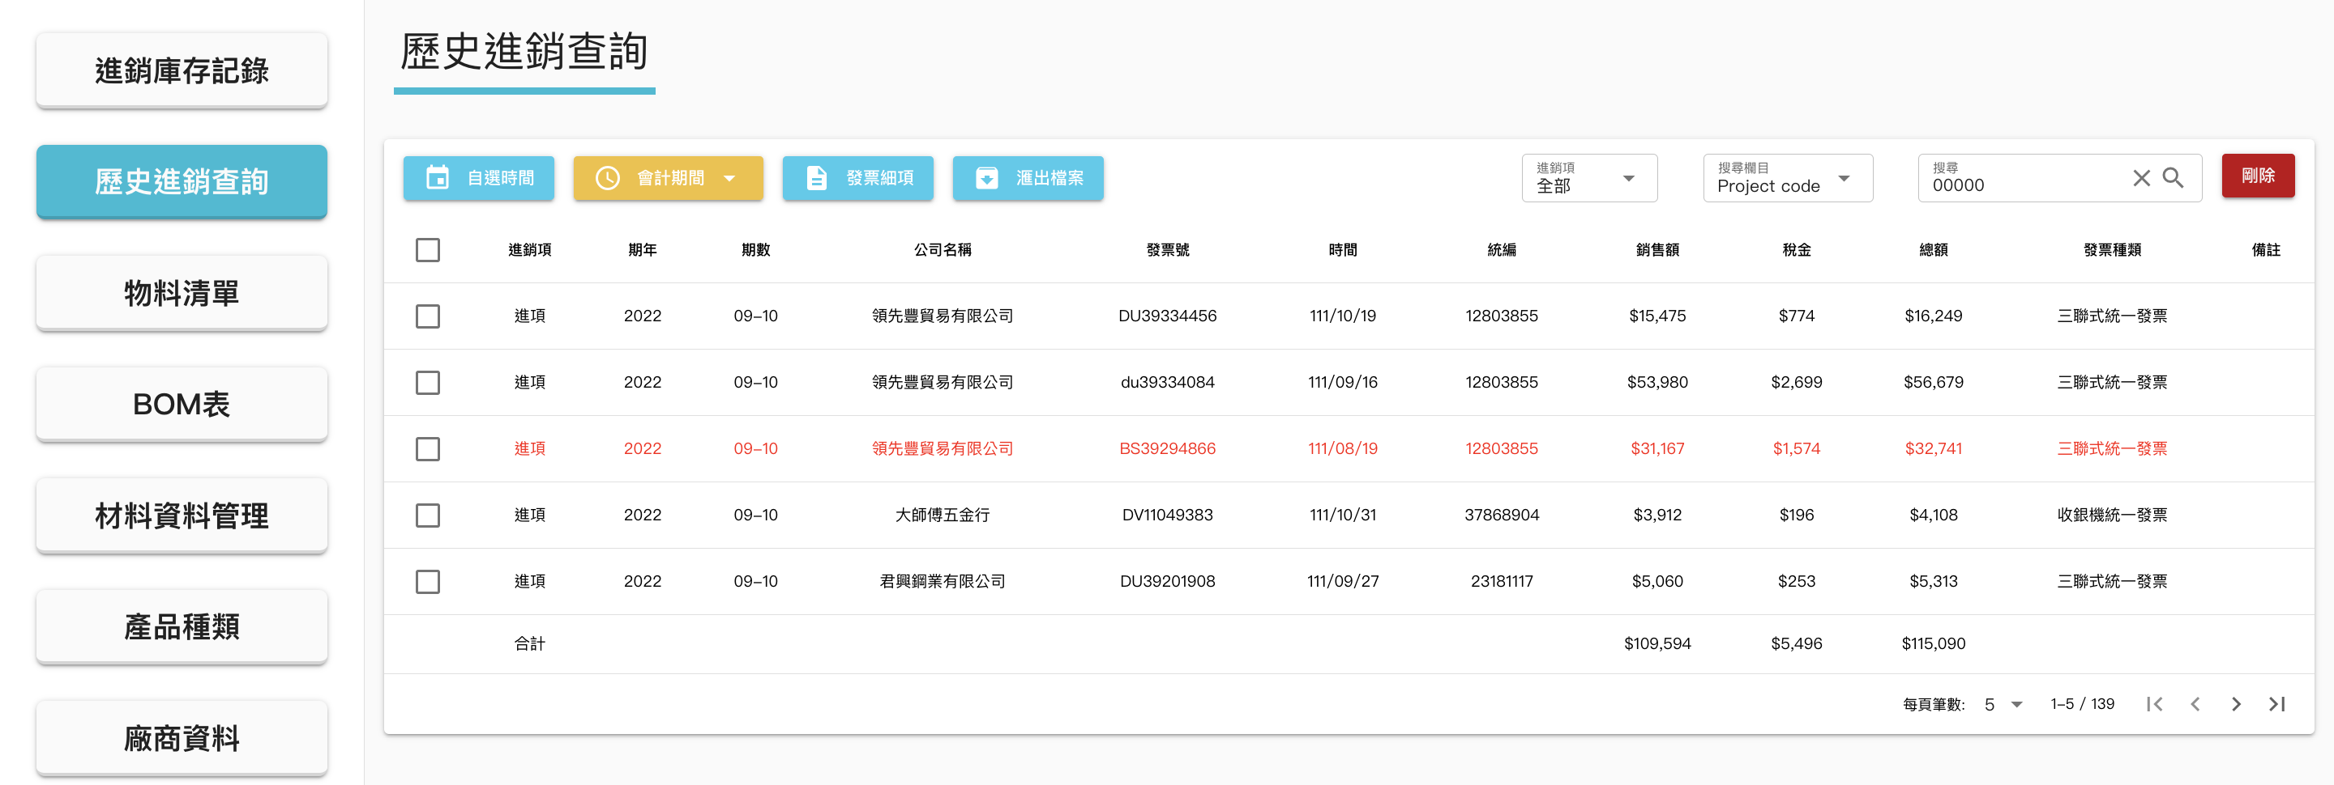
Filter by time period
Filter by accounting period
Transaction history
Transaction management
Manage transaction details, including the ability to query or delete past orders and payment information.
Offer a wide range of search criteria, such as time range, accounting period, transaction type, invoice number and project code.
Using the project code as a search parameter allows for rapid retrieval of project-specific expenses and revenues to provide real-time visibility into the company’s business operations.
Search field

Slide 23
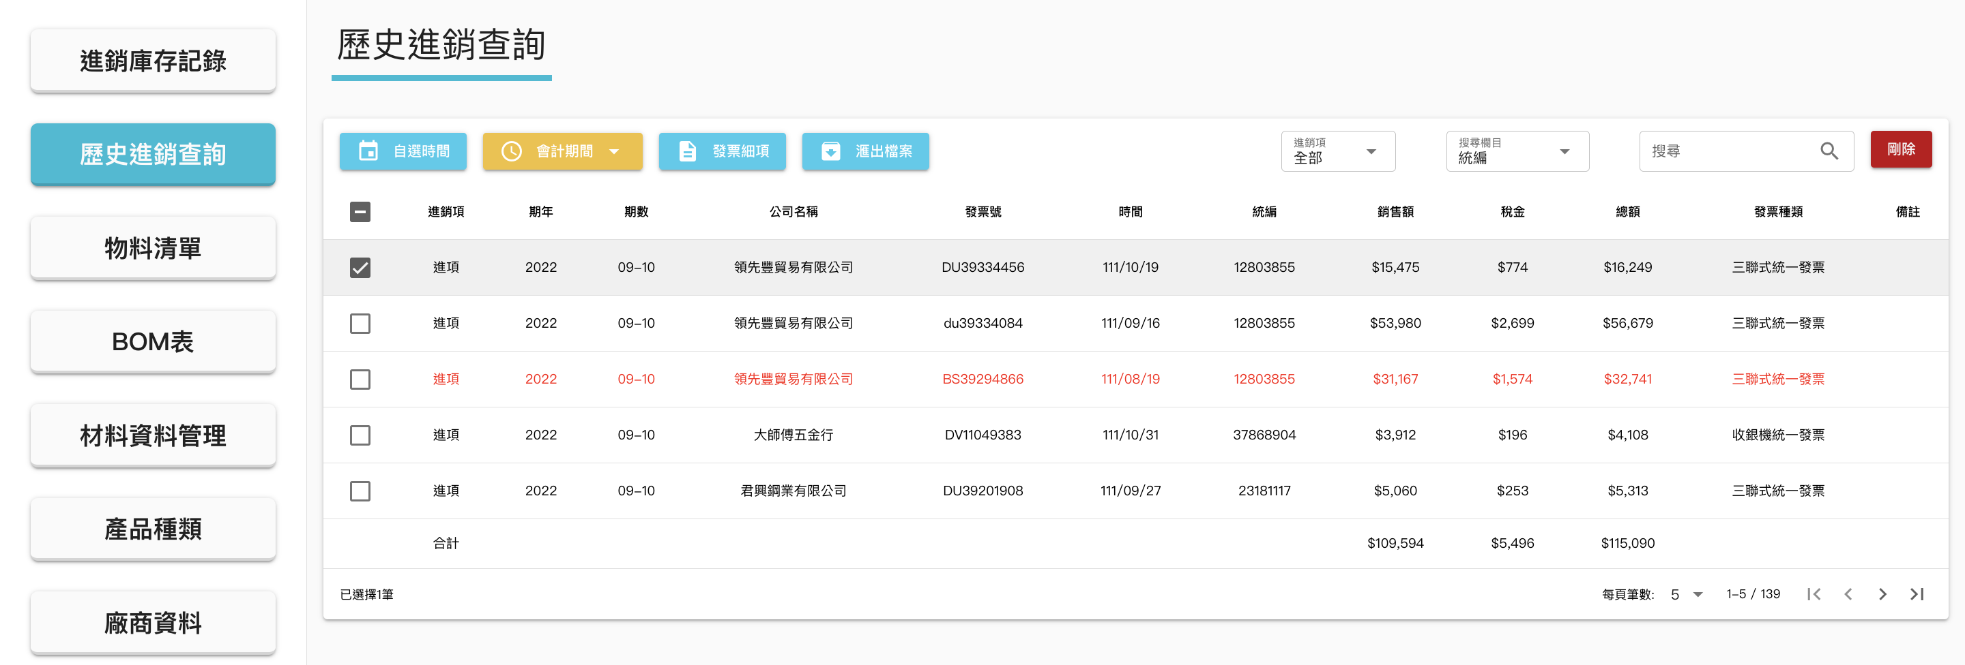
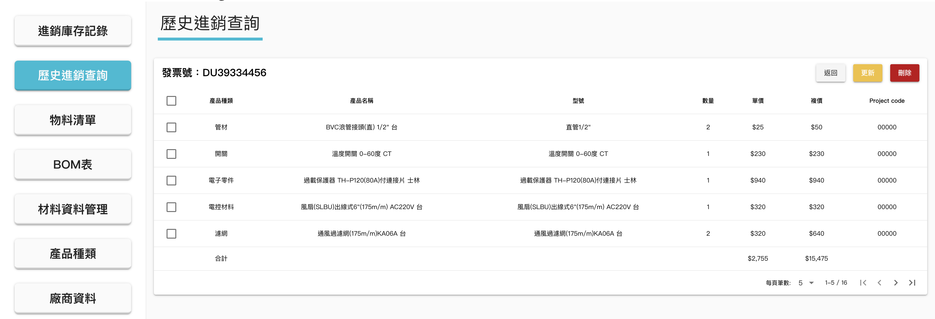
View invoie details
Transaction history
Transaction management
Users can manage (CRUD) detailed information for each order.
Track all items within each order, including the project code they are associated with.
Allow managers to access this data anytime and make informed decisions.
Invoice details

Slide 24
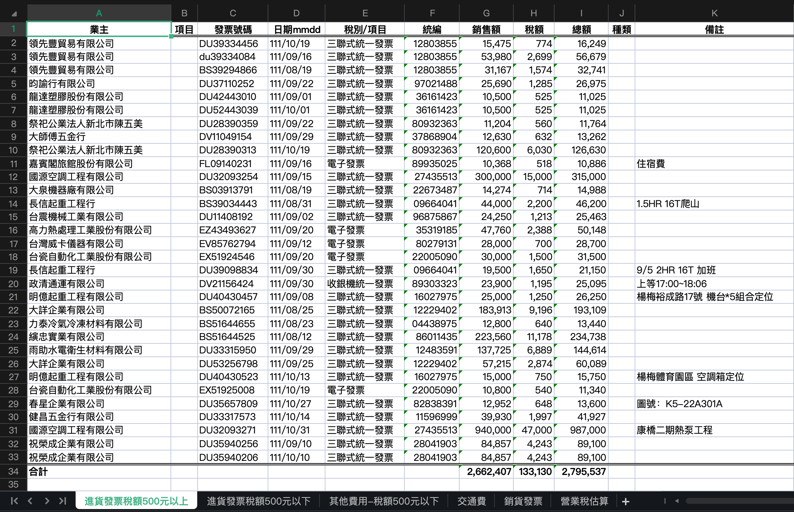
Export Excel file
Transaction history
Financial management
Offer the ability to export financial data and automatically categorize it based on invoice types, specified amounts and so on, to meet the format requirements of accounting firms and save on labor costs.
When there is a need to track the generation of specific reports and related data, it becomes easy to trace back to the corresponding records in the system.

Slide 25
#5
RentHub
GitHub:
https://github.com/Evan-Wong-FSD/RentHub-FRDProject

Slide 26

Introduction
A mobile app for rental service
As an intermediary between property owners and tenants, providing services such as property listing, rental management, and rent collection for property owners, as well as property information and consultation services for tenants.
Connect property owners and tenants, offering a convenient way to search for and rent properties.

Slide 27




Tech stack
Front end
React Native, UI Kitten, Zustand, Expo (camera, document-picker, file-system, image-picker, linking,
sharing, status-bar)
Ajax
Axios

Slide 28
Main services offered
Property Listing
Property owners can list their available properties on the platform, including detailed information, photos, and pricing. This allows tenants to find a variety of rental options in one place.
Rental Management and Rent Collection Services
The platform may provide services to property owners for managing rentals and collecting rent. This means that property owners can delegate rental tasks to the platform, such as tenant screening, lease signing, and rent collection.
Property Information and Consultation Services
For tenants, these platforms typically offer search and filtering functions, allowing them to search for suitable rental properties based on their requirements. The platforms may also provide additional services such as rental consultation, arranging property viewings, and assisting with lease agreements.

Slide 29
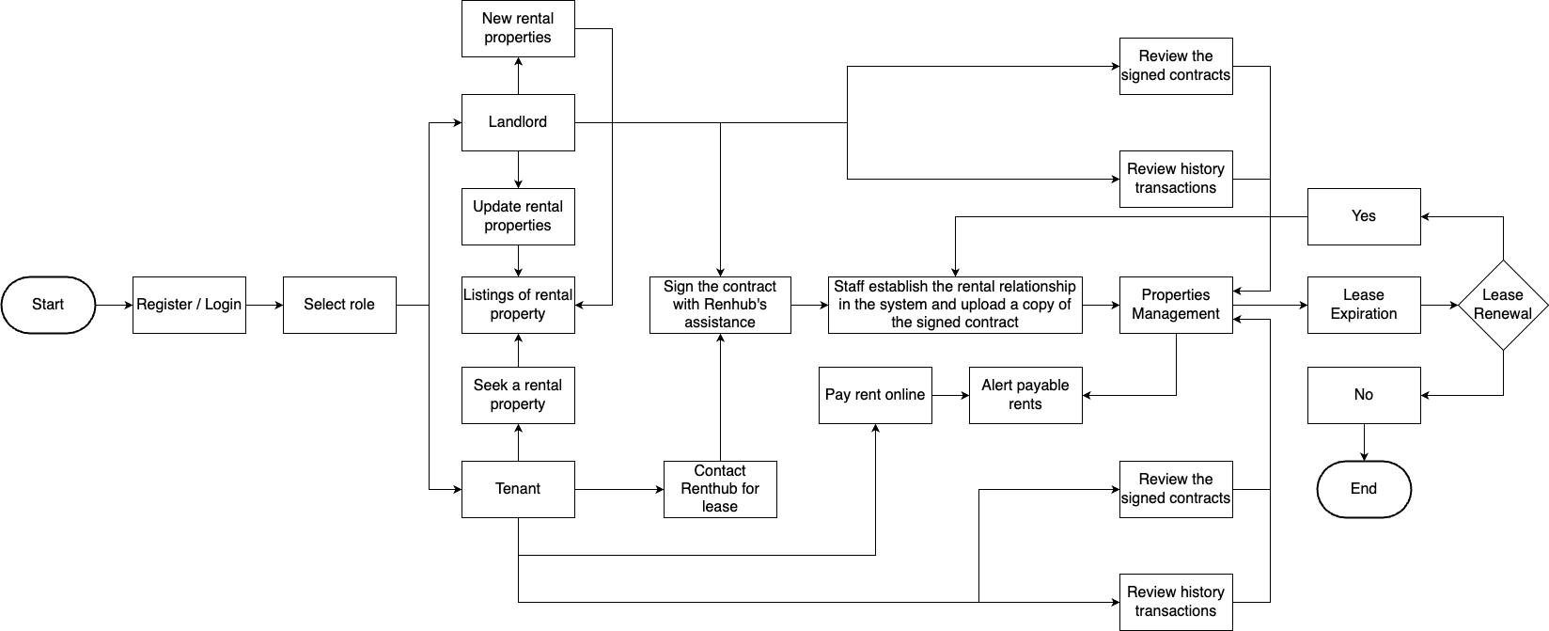
Flow Chart

Slide 30
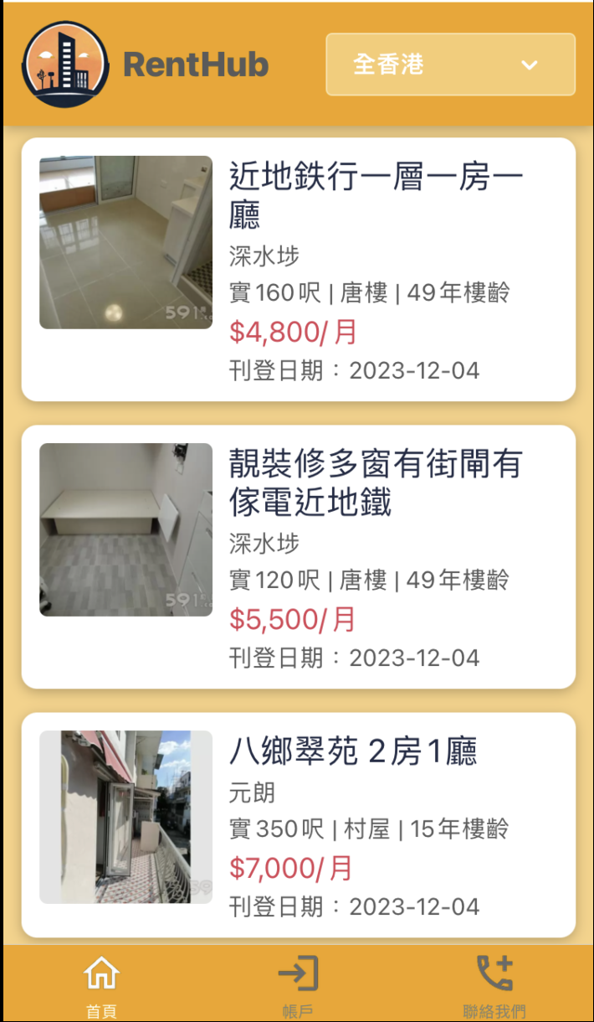
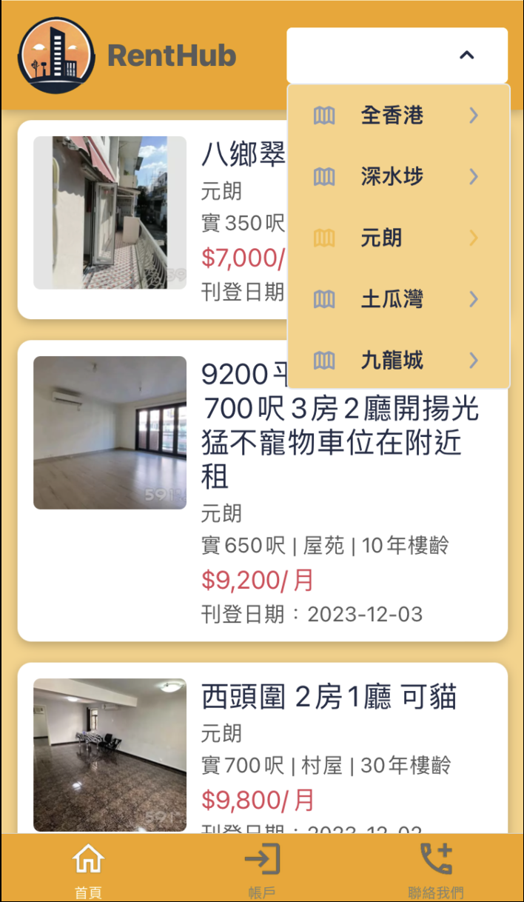
Click to provide properties in specific region.
Home page
Navigate to Property Details.
Properties Overview
In list format, provide an overview of various properties, including details such as location, size, type, age, monthly rent, and listing date.
Offer filtering by different regions in Hong Kong.
Provide pull refresh.

Slide 31
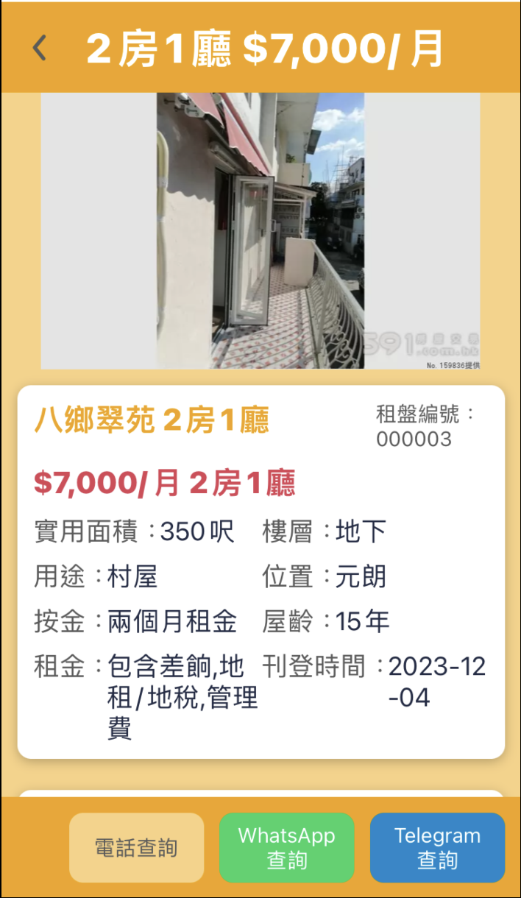
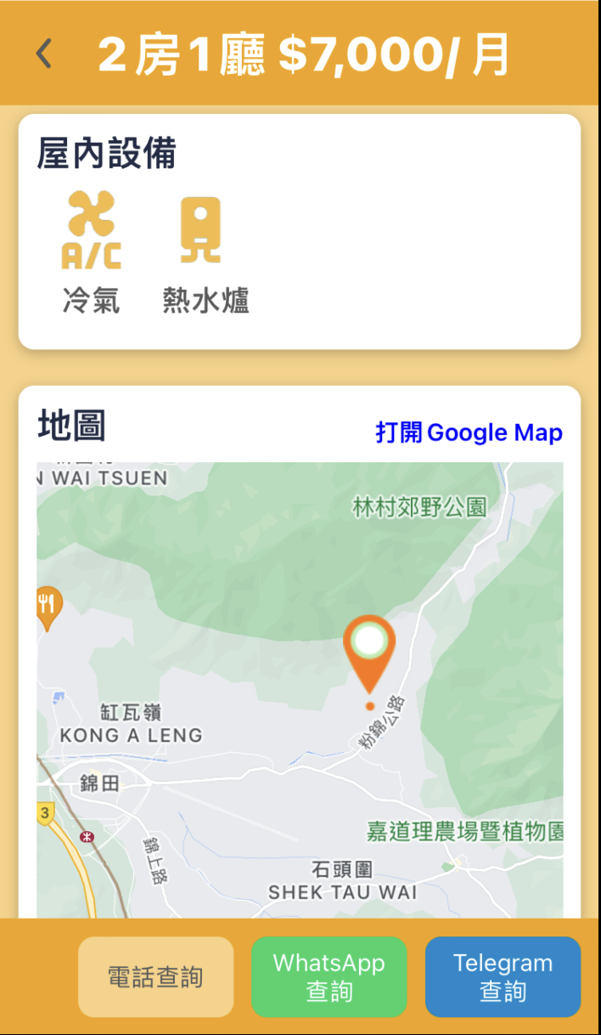
Open Google Maps and display the location of the rental property.
Rental property listings
Property Details
Image Carousel
A view with a set of swipeable images, uploaded by the property owner.
Description
Provide comprehensive property information, such as title, monthly rent and layout.
Features
List the included amenities in the rent, such as furniture, electrical appliances, and facilities.
Location
Place a marker on the map to provide the geographical location information of the rental property.
Contact
Provide phone, WhatsApp, and Telegram contact methods so interested users can reach out for further inquiries or arrange property viewings.
Redirect to phone, WhatsApp, or Telegram, providing a phone number or chat window.

Slide 32
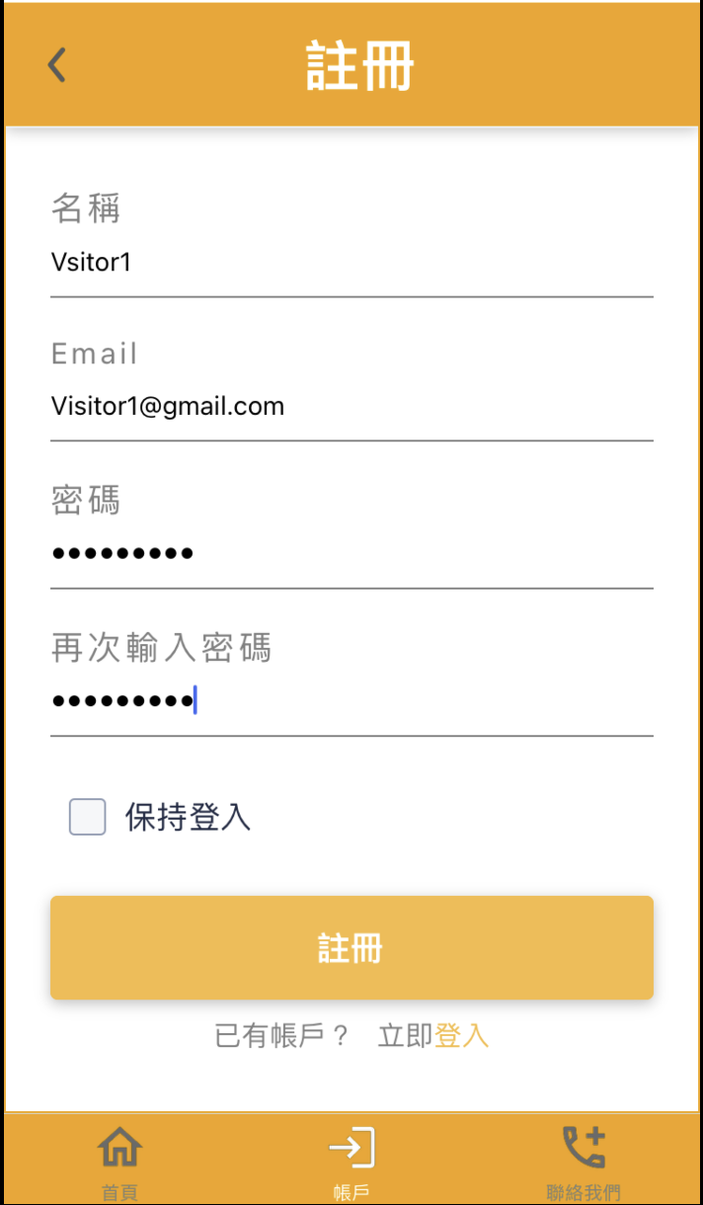
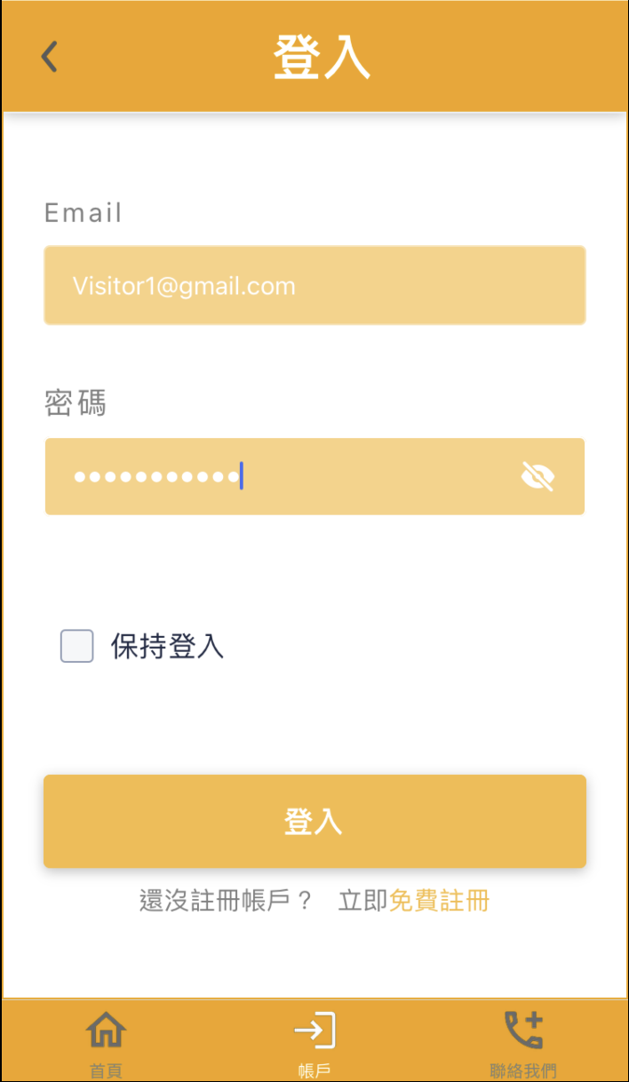
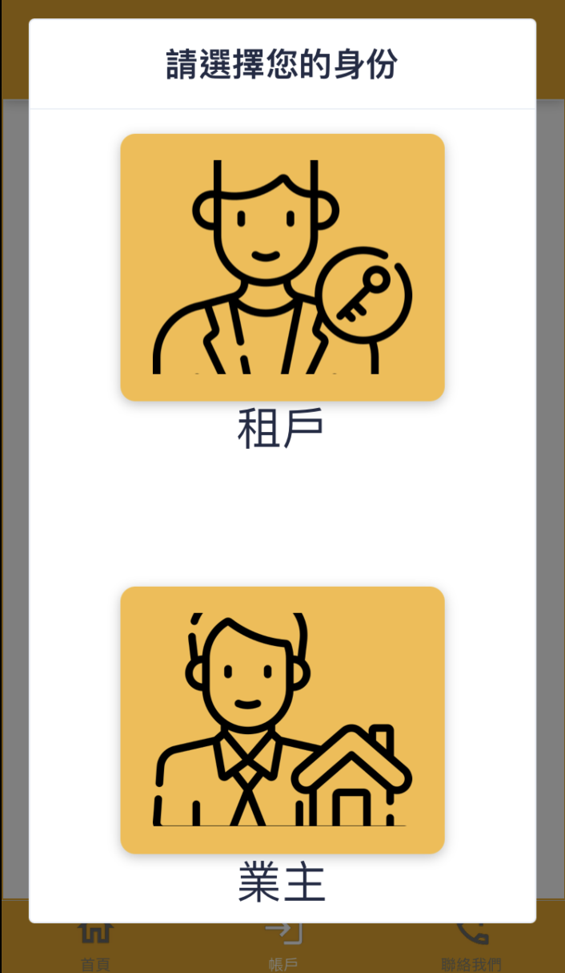
User could choose to be in different roles, including Tenant and Landlord, after login.
Register / Login
Redirect to Register page
Redirect to Login page

Slide 33
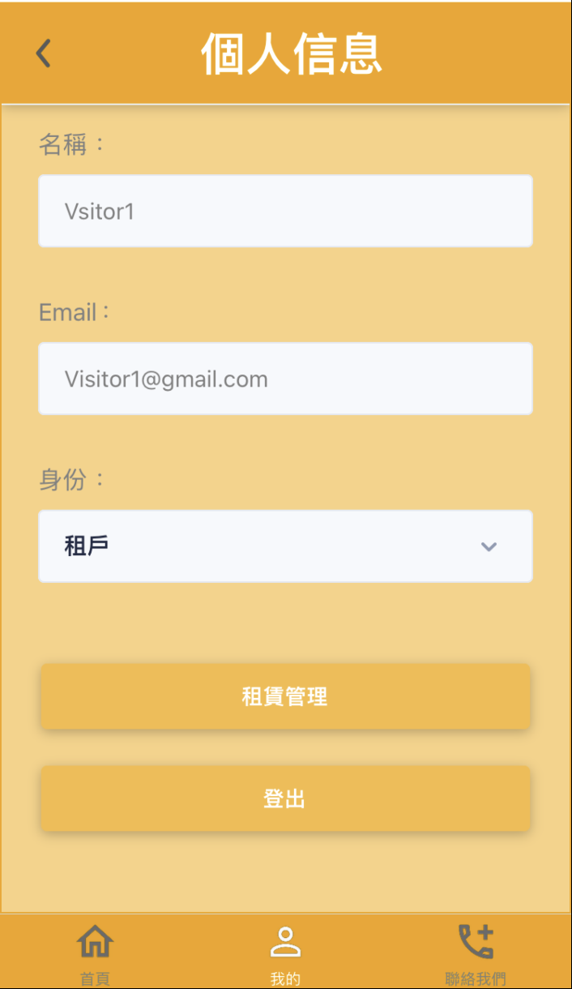
Account management
Redirect to Properties Management
Switch identity
Click to log out

Slide 34
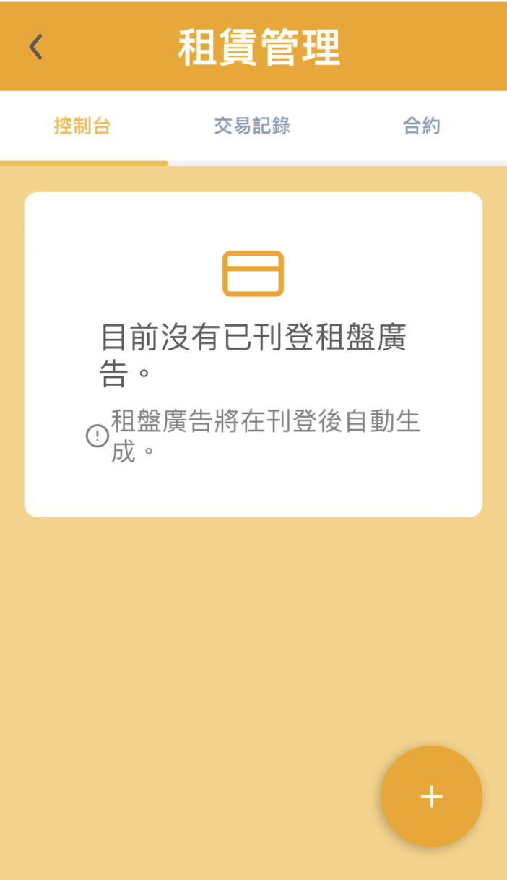
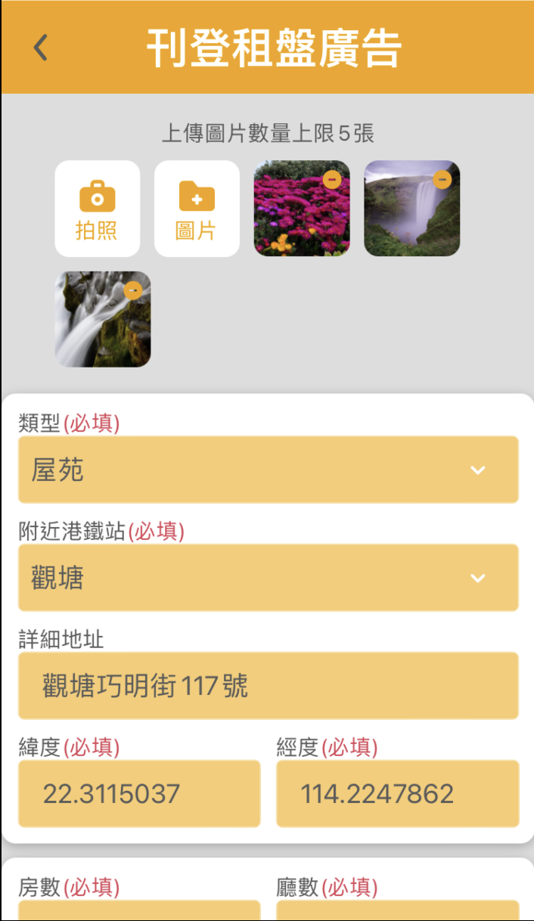
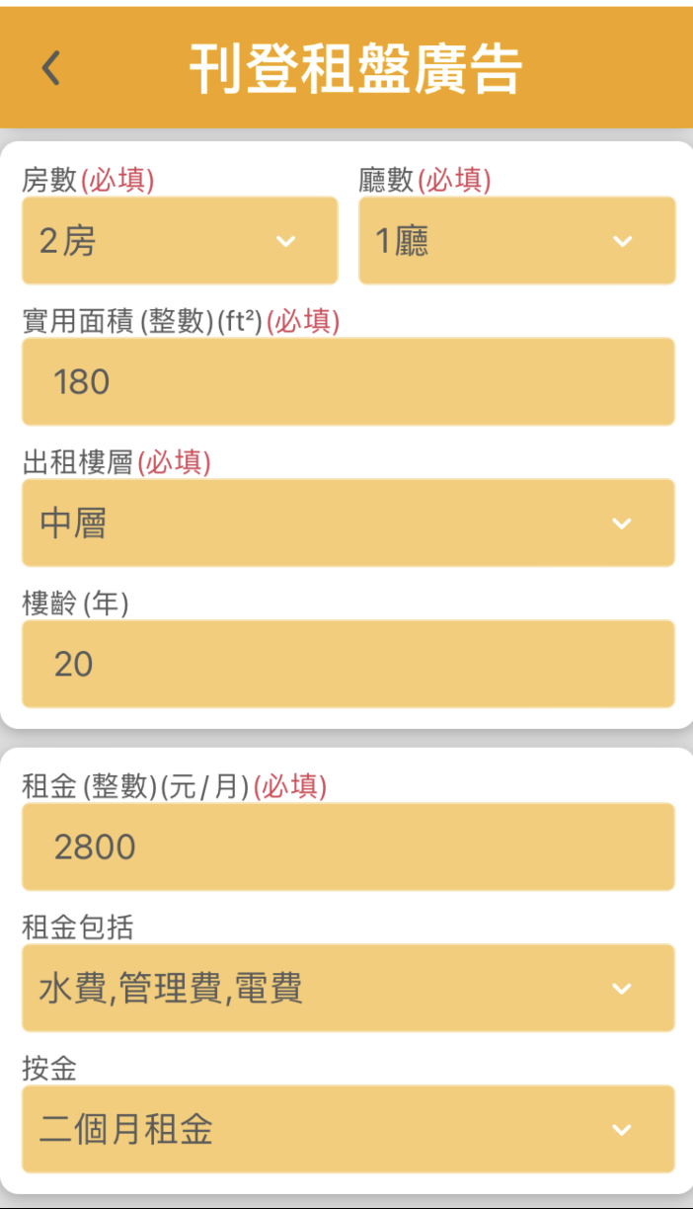
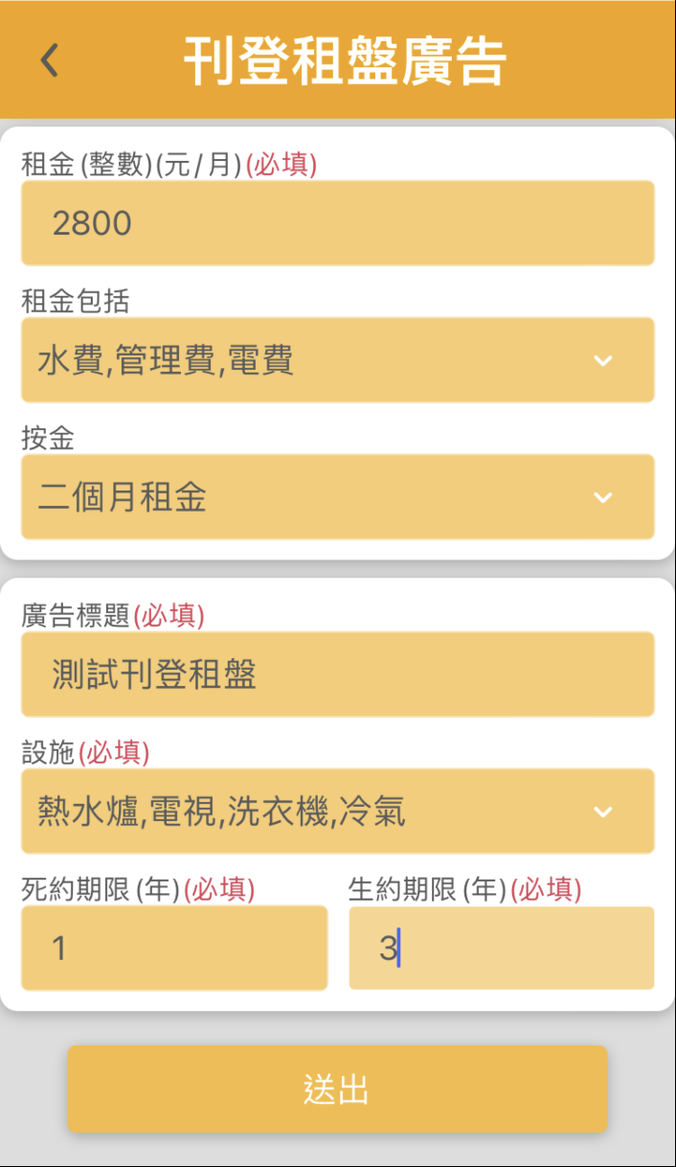
Upload photos by photographing
Uplaod photos from image media
Properties Management for Landlord
New a rental property

Slide 35
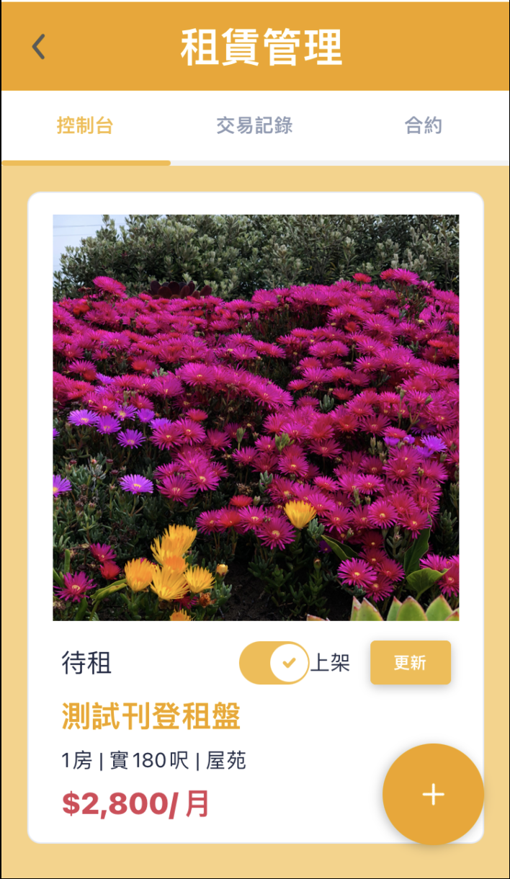
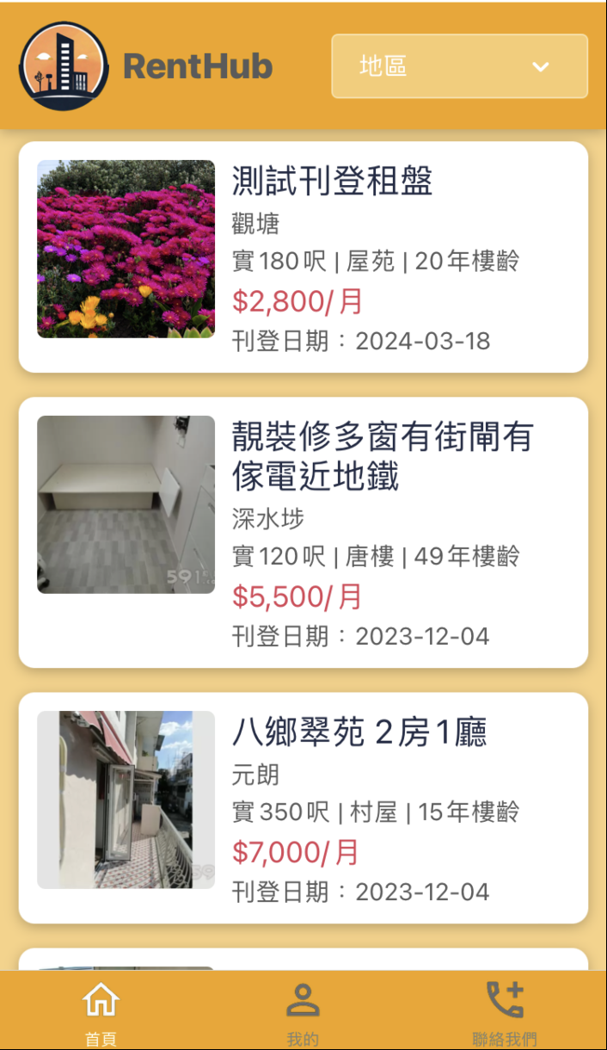
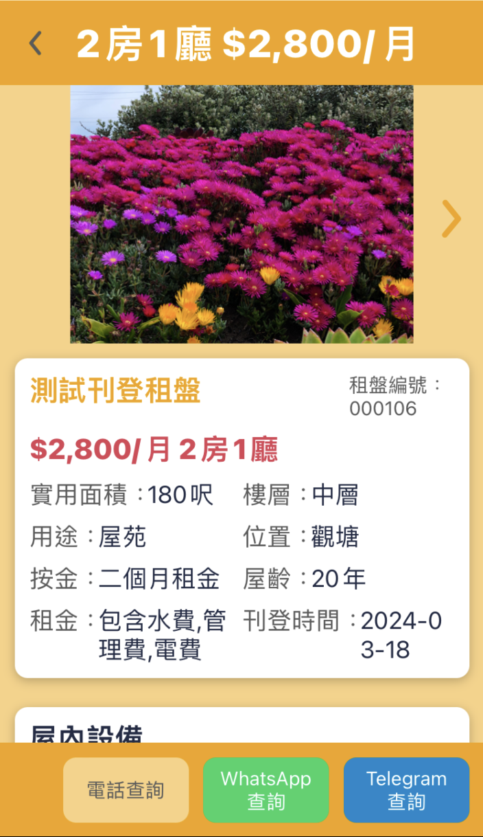
Properties Management for Landlord - Console
Newly added rental property
Control listing On/Off for the rental property
Update information of the rental property
The listing of newly added rental property

Slide 36
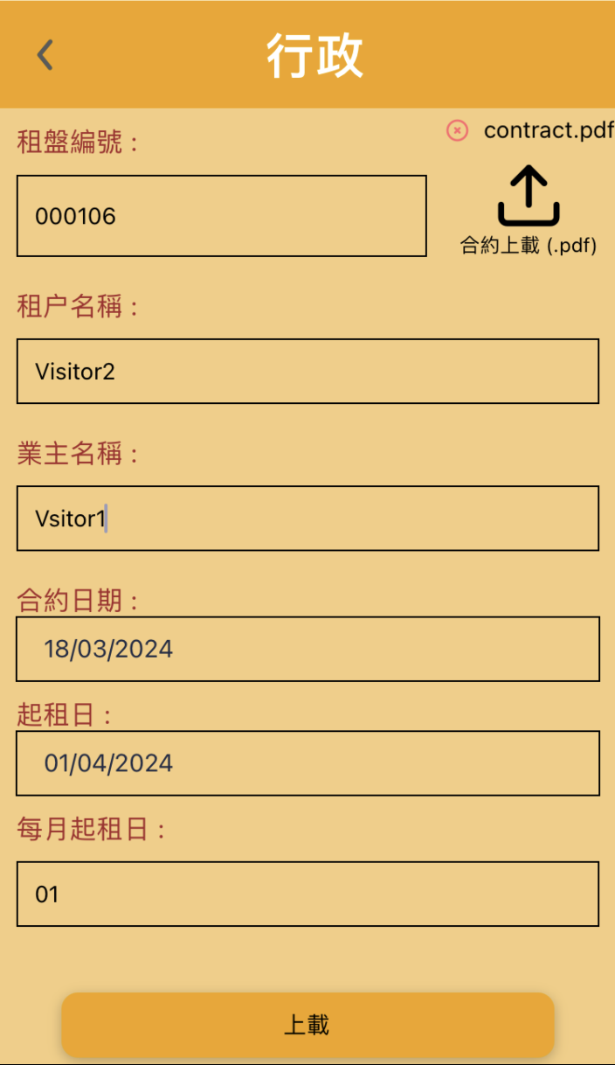
Lease Confirmed
Upload the Signed Contract.
Upload contract
Once a tenant is interested in renting a property, we will assist and facilitate the contract signing between the landlord and the tenant.
Our staff would upload the information of both the landlord and the tenant, along with the signed contract, to Renthub for convenient reference by both parties.
After uploading, both the landlord and the tenant can view the information on the Properties Management.

Slide 37



Click to download the signed contract
Contract Review
Landlord’s view
Tenant’s view
The signed contract

Slide 38




Rent Payment
Provide online payment service for tenants
Click to open the payment page in the browser
Both the landlord and the tenant could review the payment records

